Slide 1
Pathophysiology
The functional changes that accompany a particular syndrome or disease
Notes:
1

Slide 2
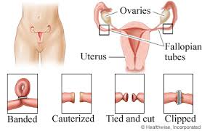
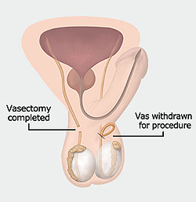
What you didn't want to ask….

Slide 3
The Lymphatic System
Supports the circulatory system and immune system
Lymph is a thin, straw-colored fluid that carries oxygen and nutrients to cells and waste products away.
Helps to rid the body of toxins and other harmful materials
Notes:
Lecture Outline
XVI. The Lymphatic System: Anatomy and Physiology
A. Composed of the spleen, lymph nodes, lymph, lymph vessels, thymus gland, and other components
B. Supports the circulatory system and immune system
C. Lymph is a thin, straw-colored fluid that carries oxygen, nutrients, and hormones to the cells and waste products of metabolism away from the cells to be excreted.
1. Lymph vessels form a network throughout the body that serves as an auxiliary to the circulatory system.
2. Lymph nodes are tiny, oval-shaped structures that filter lymph.
3. They help rid the body of toxins and other harmful materials.

Slide 4
The Endocrine System: Anatomy and Physiology
Complex message and control system
Integrates many body functions
Hormones are released directly into the bloodstream.
Each hormone has a specific effect on some organ, tissue, or process.
Notes:
Lecture Outline
XVII. The Endocrine System: Anatomy and Physiology
A. The endocrine system is a complex message and control system that integrates many body functions.
B. Endocrine glands release hormones directly into the bloodstream.
1. Each endocrine gland produces one or more hormones.
2. Each hormone has a specific effect on some organ, tissue, or process.

Slide 5
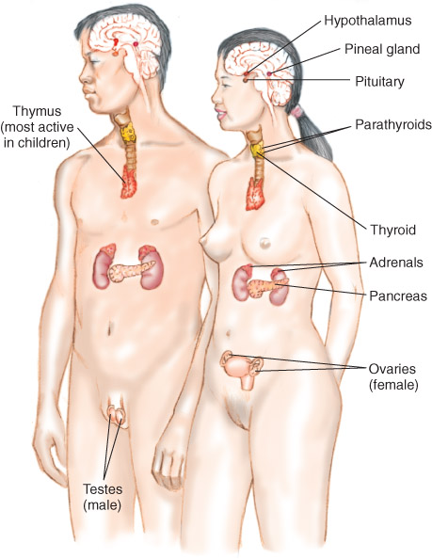
The Endocrine System:
Anatomy and Physiology
Complex message and control system
Integrates many body functions
Hormones are released directly into bloodstream.
  Examples: epinephrine, norepinephrine, insulin
Controls release of hormones in the body

Slide 6
Life Support Chain
All cells in body require oxygen, nutrients, and removal of waste.
The respiratory and circulatory systems are the carriers of these supplies and wastes.
If interference occurs, cells become damaged and die.
Notes:
Lecture Outline
XX. Life Support Chain
A. Cells are the foundation of the human body.
1. All cells in the body require oxygen, nutrients, and removal of waste.
2. The respiratory and circulatory systems are the carriers of these supplies and wastes.
3. If interference occurs, cells become damaged and die.

Slide 7
Life Support Chain
Cells use oxygen to turn nutrients into chemical energy through metabolism.
  Adenosine triphosphate (ATP) is used to store energy.
Aerobic metabolism uses oxygen.
Cells switch to anaerobic metabolism when oxygen is limited.
Anaerobic metabolism: Body creates energy through the combustion of Glucose in the ABSENCE of oxygen. Produces lactic acid as a byproduct. Lactic acid builds up leads to fatigue and more ….
Aerobic metabolism: Body creates energy through the combustion of carbohydrates, amino acids, and fats in the presence of oxygen. Produces heat, water and carbon dioxide as byproducts.
Notes:
Lecture Outline
B. Cells use oxygen to take available nutrients and turn them into chemical energy through metabolism.
1. Adenosine triphosphate (ATP) is used to store energy.
2. Aerobic metabolism uses oxygen.
3. Cells switch to anaerobic metabolism when oxygen is limited.
4. Movement of oxygen, waste, and nutrients occurs by diffusion.

Slide 8
Pathophysiology
The functional changes that accompany a particular syndrome or disease
Notes:
8

Slide 9
Pathophysiology
Example
Respiratory compromise can lead to:
  Hypoxia
  Hypercarbia
Notes:
Lecture Outline
3. Factors that impair respiration:
a. Change in the atmosphere
b. High altitudes
c. Impaired movement of the gas across the cell membrane

Slide 10
Pathophysiology
Factors that impair ventilation:
  Blocked airway
  Impairment of the muscles of breathing
  Physiologic obstruction of the airway (asthma)
  Other factor
Factors that impair respiration:
  Change in atmosphere
  High altitudes
  Impaired movement of the gas across the cell membrane
Notes:
Lecture Outline
3. Factors that impair respiration:
a. Change in the atmosphere
b. High altitudes
c. Impaired movement of the gas across the cell membrane

Slide 11
Pathophysiology
Effects of respiratory compromise on the body:
  Oxygen levels fall and carbon dioxide levels rise.
  Respiratory rate increases.
  Blood becomes more acidic.
  The brain sends commands to the body to breathe.
Notes:
Lecture Outline
C. Effects of respiratory compromise on the body
1. Oxygen levels throughout the body fall and carbon dioxide levels rise.
2. The brain detects an increase in carbon dioxide levels.
3. The body increases its respiratory rate in an attempt to return the carbon dioxide levels to normal.
4. If increased respiratory does not occur or is not effective in returning the carbon dioxide levels to normal, the blood will become more acidic.
5. Blood oxygen levels will begin to fall, which will cause the brain to issue further commands to breathe.

Slide 12
Shock
Shock is the condition of not enough blood flow to the tissues of the body as a result of problems with the circulatory system.
  Lack of Perfusion
Notes:
Lecture Outline
D. Shock
1. A condition in which organs and tissue receive an inadequate flow of blood and oxygen
2. Impaired oxygen delivery causes cellular hypoxia, which leads to anaerobic metabolism, lactic acid production, and organ dysfunction.
3. Shock is categorized into several types depending on the cause.

Slide 13
Shock
Categorized into several types depending on the cause
  Cardiogenic: Due to heart problems
  Hypovolemic: Caused by too little blood
  volume
  Anaphylactic: Caused by allergic reaction
  Septic: Due to infection
  Neurogenic: Caused by nervous system
  damage
Notes:
Lecture Outline
D. Shock
1. A condition in which organs and tissue receive an inadequate flow of blood and oxygen
2. Impaired oxygen delivery causes cellular hypoxia, which leads to anaerobic metabolism, lactic acid production, and organ dysfunction.
3. Shock is categorized into several types depending on the cause.

Slide 14
Shock
Effects of shock on the body:
  Level of oxygen supplied to tissues falls
  Cells engage in anaerobic metabolism
  Severe metabolic acidosis ensues
  Baroreceptors initiate release of epinephrine and norepinephrine
  Heart rate increases
  Interstitial fluid moves into the capillaries
Notes:
Lecture Outline
E. The effects of shock on the body are similar to those of respiratory compromise.
1. The level of oxygen supplied to the tissues falls.
2. Cells engage in anaerobic metabolism, resulting in lactic acid production.
3. Severe metabolic acidosis ensues, leading to increased levels of carbon dioxide within the blood.
4. Baroreceptors detect decreased blood pressure and initiate the release of epinephrine and norepinephrine.
5. The heart rate increases, the heart beats more forcefully, and blood vessels constrict.
6. Interstitial fluid moves into the capillaries.

Slide 15
Impairment of Cellular Metabolism
Results in the inability to properly use oxygen and glucose at the cellular level
Cells create energy through anaerobic metabolism.
Can result in metabolic acidosis
Brain cells cannot use alternative fuels.
Cellular injury may become irreversible.
Notes:
Lecture Outline
F. Impairment of cellular metabolism results in the inability to properly use oxygen and glucose at the cellular level.
1. When there is inadequate oxygen, cells will create energy through anaerobic metabolism.
a. Can result in metabolic acidosis
b. Requires more energy than when using glucose for fuel
c. Decreases the blood’s ability to effectively carry oxygen to the cells
d. Decreases the functioning of oxygen within the cell
e. Brain cells cannot use alternative fuels.
i. If their supply of glucose decreases dramatically, brain cells will quickly become damaged or die.
f. Cellular injury, up to a point, may be repairable if normal tissue perfusion is restored.

Slide 16

Cellular Metabolism
Notes:
Teaching Time
45 minutes
16

Slide 17
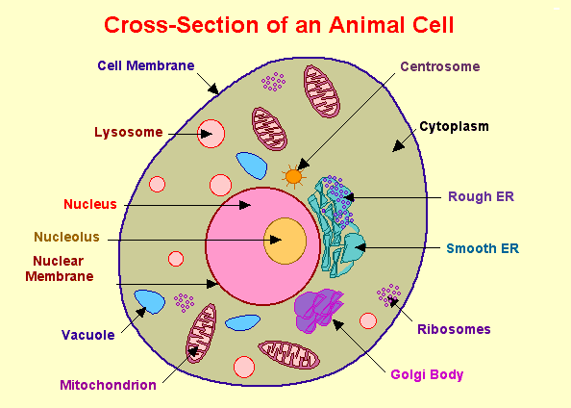
Cell Structure

Slide 18

Cell Structure

Slide 19
Cellular Energy Production

Slide 20
Glycolysis
When glucose crosses the cell membrane, it is broken down into pyruvic acid
  Does not require oxygen.
Glycolysis releases only a small amount (2 moles) of adenosine triphosphate (ATP).
  ATP is an energy source required by the cell.
Notes:
When glucose crosses the cell membrane, it is broken down into pyruvic acid. This process, known as glycolysis, does not require oxygen. Glycolysis releases only a small amount (2 moles) of adenosine triphosphate (ATP).
ATP is an energy source required by the cell. When oxygen is available, the reaction continues inside the mitochondria of the cell where the process releases a much larger amount of energy (36 moles of ATP). Again, this large amount of energy (ATP) is critical to normal cell function.
Other byproducts of aerobic metabolism include heat, carbon dioxide, and water. The heat produced is used to maintain a normal body core temperature. An increased metabolism results in increased body core temperature. Carbon dioxide is transported in the blood and blown off in the exhalation phase of normal respiration. Water is reabsorbed and used within the body or excreted. All of the products of aerobic metabolism are either used by the body or eliminated, and a high amount of energy is created for cells to function.

Slide 21
Glycolysis
If oxygen is available the reaction continues inside the mitochondria of the cell
This process releases a much larger amount of energy (36 moles of ATP).
This large amount of energy (ATP) is critical to normal cell function.
Notes:
When glucose crosses the cell membrane, it is broken down into pyruvic acid. This process, known as glycolysis, does not require oxygen. Glycolysis releases only a small amount (2 moles) of adenosine triphosphate (ATP).
ATP is an energy source required by the cell. When oxygen is available, the reaction continues inside the mitochondria of the cell where the process releases a much larger amount of energy (36 moles of ATP). Again, this large amount of energy (ATP) is critical to normal cell function.
Other byproducts of aerobic metabolism include heat, carbon dioxide, and water. The heat produced is used to maintain a normal body core temperature. An increased metabolism results in increased body core temperature. Carbon dioxide is transported in the blood and blown off in the exhalation phase of normal respiration. Water is reabsorbed and used within the body or excreted. All of the products of aerobic metabolism are either used by the body or eliminated, and a high amount of energy is created for cells to function.

Slide 22
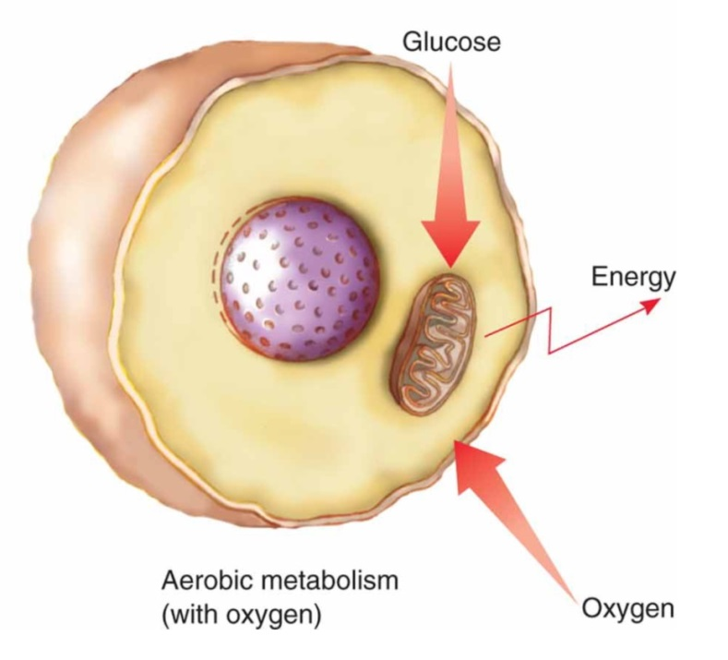
Aerobic Metabolism
(Adequate amount of oxygen available)
A large amount of energy is produced
Generated waste products are in a form that can be easily eliminated by the body.
Byproducts of aerobic metabolism
  Heat
  Carbon dioxide
  Water
Notes:
When glucose crosses the cell membrane, it is broken down into pyruvic acid. This process, known as glycolysis, does not require oxygen. Glycolysis releases only a small amount (2 moles) of adenosine triphosphate (ATP).
ATP is an energy source required by the cell. When oxygen is available, the reaction continues inside the mitochondria of the cell where the process releases a much larger amount of energy (36 moles of ATP). Again, this large amount of energy (ATP) is critical to normal cell function.
Other byproducts of aerobic metabolism include heat, carbon dioxide, and water. The heat produced is used to maintain a normal body core temperature. An increased metabolism results in increased body core temperature. Carbon dioxide is transported in the blood and blown off in the exhalation phase of normal respiration. Water is reabsorbed and used within the body or excreted. All of the products of aerobic metabolism are either used by the body or eliminated, and a high amount of energy is created for cells to function.

Slide 23
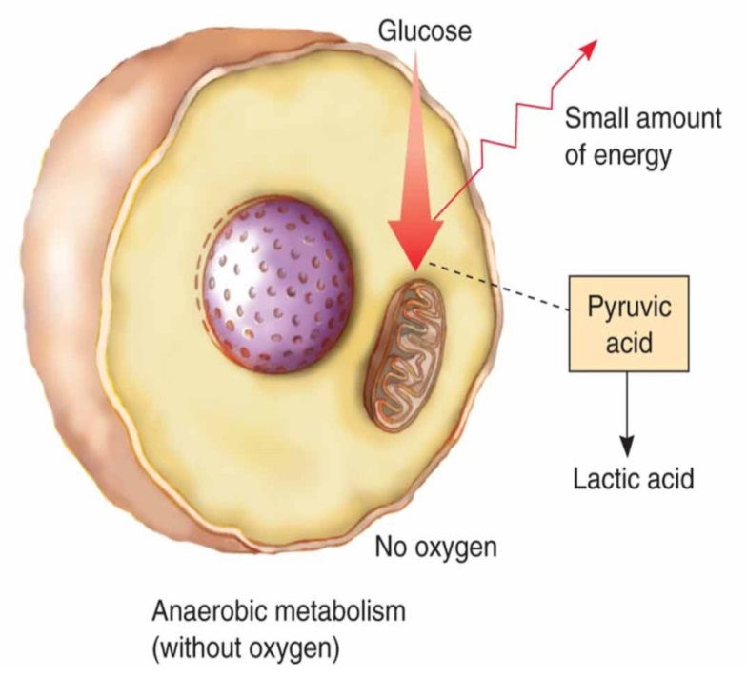
Anaerobic Metabolism
(Without adequate oxygen)
Much less energy is produced
Waste products accumulate.
The byproduct of anaerobic metabolism is lactic acid.
  When lactic acid
  accumulates, the functions
  of the cell are disrupted,
  and the cell may be
  damaged or die.
Notes:
Discussion Question
What are the consequences of inadequate oxygenation of the body’s tissues?
Points to Emphasize
Without adequate oxygen much less energy is produced, and waste products accumulate.
The byproduct of anaerobic metabolism is lactic acid. When lactic acid accumulates, the functions of the cell are disrupted, and the cell may be damaged or die.
The sodium-potassium pump of cells requires energy to keep the right amount of potassium inside the cell and the right amount of sodium outside the cell.

Slide 24
Lactic Acidosis
Symptoms include rapid breathing, burning feeling in your muscles, cramps, nausea, weakness, and feeling exhausted.
Occurs when too much Lactic acid builds up in your bloodstream.
The most common cause is intense exercise.
(Cont)

Slide 25
Lactic Acidosis
When you exercise, your body uses oxygen to break down glucose for energy.
During intense exercise, there may not be enough oxygen available to complete the process, and lactic acid is made.
Your body can convert this to energy without using oxygen, but it can build up in your bloodstream faster than you can burn it off

Slide 26
Anaerobic Metabolism
Sodium/Potassium Pump
Operation and Failure
Notes:
Talking Points
To perform special functions such as muscle contraction and nerve impulse transmission, body cells require an alternating movement of sodium and potassium into and out of the cells.
This is facilitated by the sodium/potassium pump.
For the sodium/potassium pump to work, energy is required. The energy is in the form of ATP, which is released through glycolysis and the breakdown of glucose within the cells.
One detrimental effect of anaerobic metabolism or the lack of glucose delivery to cells is related to the function of the sodium/potassium pump. If there is a lack of ATP or energy production by cells, as found in poor perfusion states and anaerobic metabolism, the sodium/potassium pump may fail.
If the pump fails, sodium will collect on the inside of the cell. As is well known, water follows salt (sodium) and as the water continues to accumulate, the cell swells and eventually ruptures and dies. Thus the end result of a lack of energy to run the pump is cell death.

Slide 27
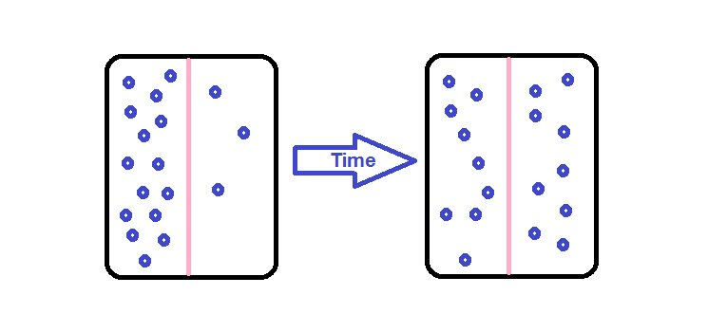
Diffusion
The passive process in which molecules move from an area with a higher concentration to an area of lower concentration.
Notes:
Lecture Outline
1. Respiration
a. Respiration: the exchange of oxygen and carbon dioxide in the alveoli and in tissues of the body
b. Diffusion: the passive process in which oxygen molecules move from an area with a higher concentration of oxygen molecules to an area of lower concentration.
c. The brain stem automatically controls breathing if the level of carbon dioxide or oxygen in arterial blood is too high or too low.
i. The medulla initiates the ventilation cycle when stimulated by high carbon dioxide levels.

Slide 28
Sodium/Potassium Pump
Sodium and potassium are electrically charged molecules (ions).
Sodium (Na+) is found primarily outside of the cell.
Potassium (K+) is primarily found inside of the cell.
The sodium/potassium pump exchanges Na for K in a continuous cycle.

Slide 29
Cellular Metabolism
To function properly and efficiently, potassium must be “pumped” INTO the cell and sodium must be pumped out of the cell
  The sodium-potassium pump requires energy to maintain potassium inside the cell and sodium outside the cell
Energy is produced when glucose molecules are broken down in the cell.

Slide 30
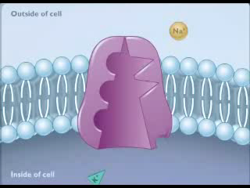
Sodium – Potassium Pump

Slide 31
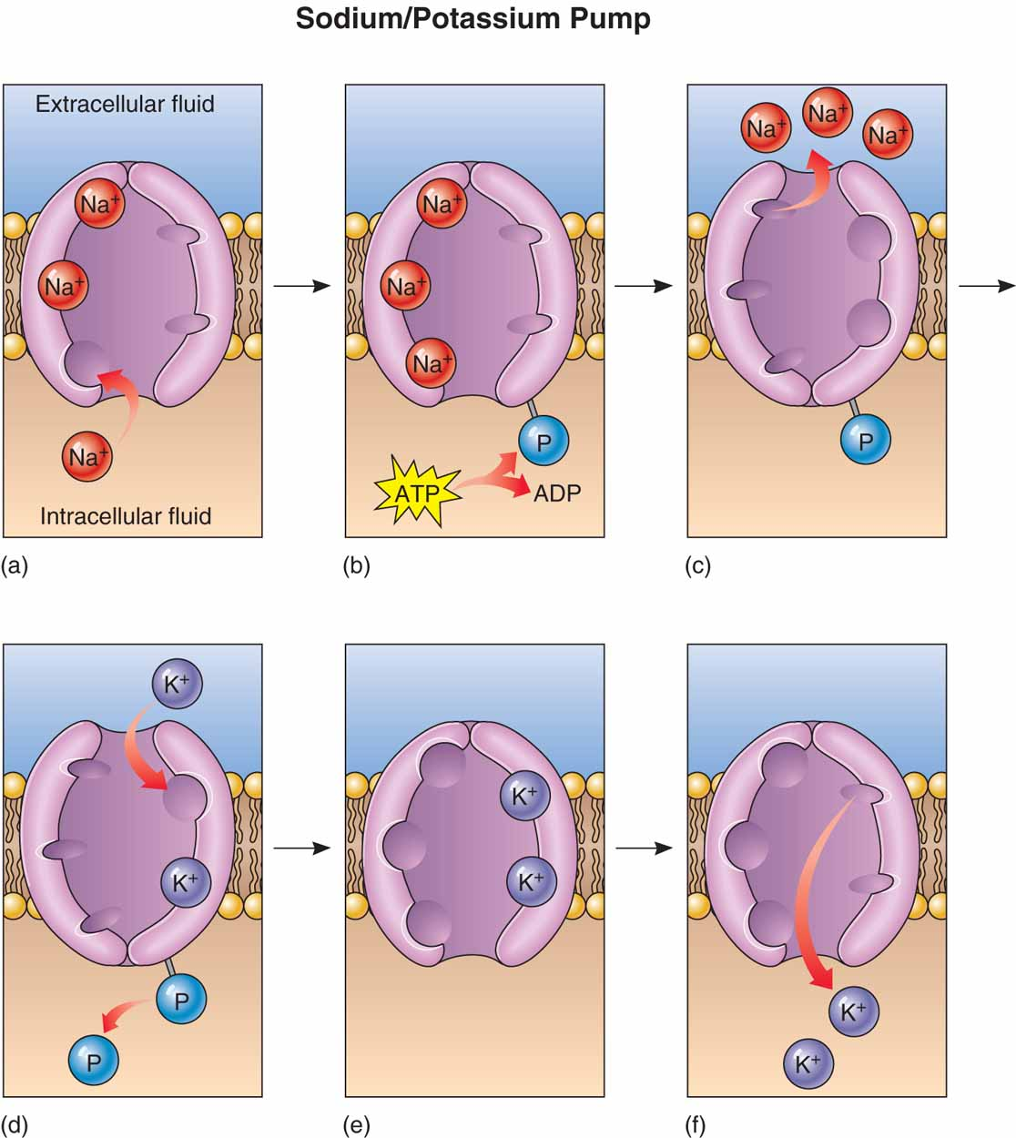
Function of pump
Failure of pump
Effect of failure
Notes:
Talking Points
Sodium and potassium are ions (electrically charged molecules).
Sodium (Na⁺) is a positively charged ion found primarily in the fluid outside of the cell.
Potassium (K⁺) is also positively charged and is found primarily in the fluid on the inside of the cell.
The sodium/potassium pump exchanges sodium for potassium in a continuous cycle. This is the only way that cells can continue to perform special functions like nerve stimulation.
The effect on the cell of failure of the sodium/potassium pump is an example of how a lack of adequate delivery of oxygen and glucose to cells can lead to cell death and organ failure.
It is also an example of why, as stated earlier, maintaining delivery of oxygen and glucose to the cells and elimination of waste products from the cells is a fundamental purpose of emergency care for any patient.
31

Slide 32
Sodium/Potassium Pump Failure
Results in a build-up of Na in the cell.
Results in a build-up of K outside the cell
A buildup of Na in the cells results in an excessive build-up of water in the cell.
  Build-up of water in the cell results in cell rupture and cell death

Slide 33
Components Necessary for Adequate Perfusion
(Perfusion: Delivery of oxygen, glucose, and other substances to the cells and the elimination of waste products from the cells.)
Notes:
Teaching Time
120 minutes
Points to Emphasize
Perfusion is the delivery of oxygen, glucose, and other substances to the cells and the elimination of waste products from the cells.
Any condition that interferes with any of the components needed for adequate perfusion can result in anaerobic metabolism.
Class Activity
Assign students to play the role of various components of perfusion (red blood cells, right ventricle, and so on.). Encourage students to select a name for their component, such as Larry the Left Ventricle. Students will spend five to ten minutes writing the biography of their component and then present it to the class.
Critical Thinking Discussion
How do the nervous, respiratory, and circulatory systems all work together to maintain adequate perfusion?
33

Slide 34
Components of the "delivery" and "removal" system
Composition of ambient air
Patent airway
Mechanics of ventilation
Regulation of ventilation
Ventilation/perfusion ratio (V/Q)
Transport of O₂ and CO₂ by the blood
Blood volume
Pump function of the myocardium
Systemic vascular resistance
Microcirculation
Blood pressure
Notes:
Talking Points
In order to maintain adequate perfusion, the components of the delivery and removal system must work properly. These components are:
– Composition of ambient air
– Patent airway
– Mechanics of ventilation
– Regulation of ventilation
– Ventilation/perfusion ratio
– Transport of oxygen and carbon dioxide by the blood
– Blood volume
– Pump function of the myocardium
– Systemic vascular resistance
– Microcirculation
– Blood pressure
An alteration in any one of these components may lead to poor cellular perfusion with an inadequate delivery of oxygen or glucose to the cell or inadequate elimination of carbon dioxide and other waste products.
34

Slide 35
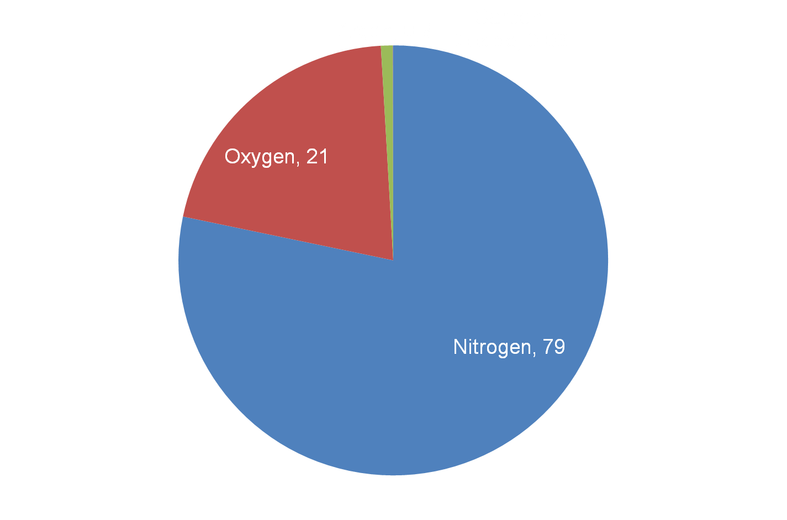
Composition of Ambient Air
(at sea level)
Notes:
Talking Points
The concentration of oxygen in the ambient air will determine the proportion of oxygen molecules that end up in the alveoli available for gas exchange with the blood.
A lesser proportion of oxygen in the blood means less oxygen for cells to use for metabolism.
Ambient air at sea level contains about 79 percent nitrogen, 21 percent oxygen, 0.9 percent argon, and 0.03 percent carbon dioxide. There are trace amounts of other gases.
If the patient is in a low oxygen environment, such as an enclosed space with toxic gases, the reduced oxygen concentration will result in cellular hypoxia. Ensure the concentration of oxygen the patient is breathing is at least 21 percent.
Increasing the concentration of oxygen in breathed air will increase the number of oxygen molecules in the alveoli, the blood, and the cells.
One way to improve cellular oxygenation is by increasing the concentration of oxygen in the air breathed in by the patient, such as with a nonrebreather mask.
35

Slide 36
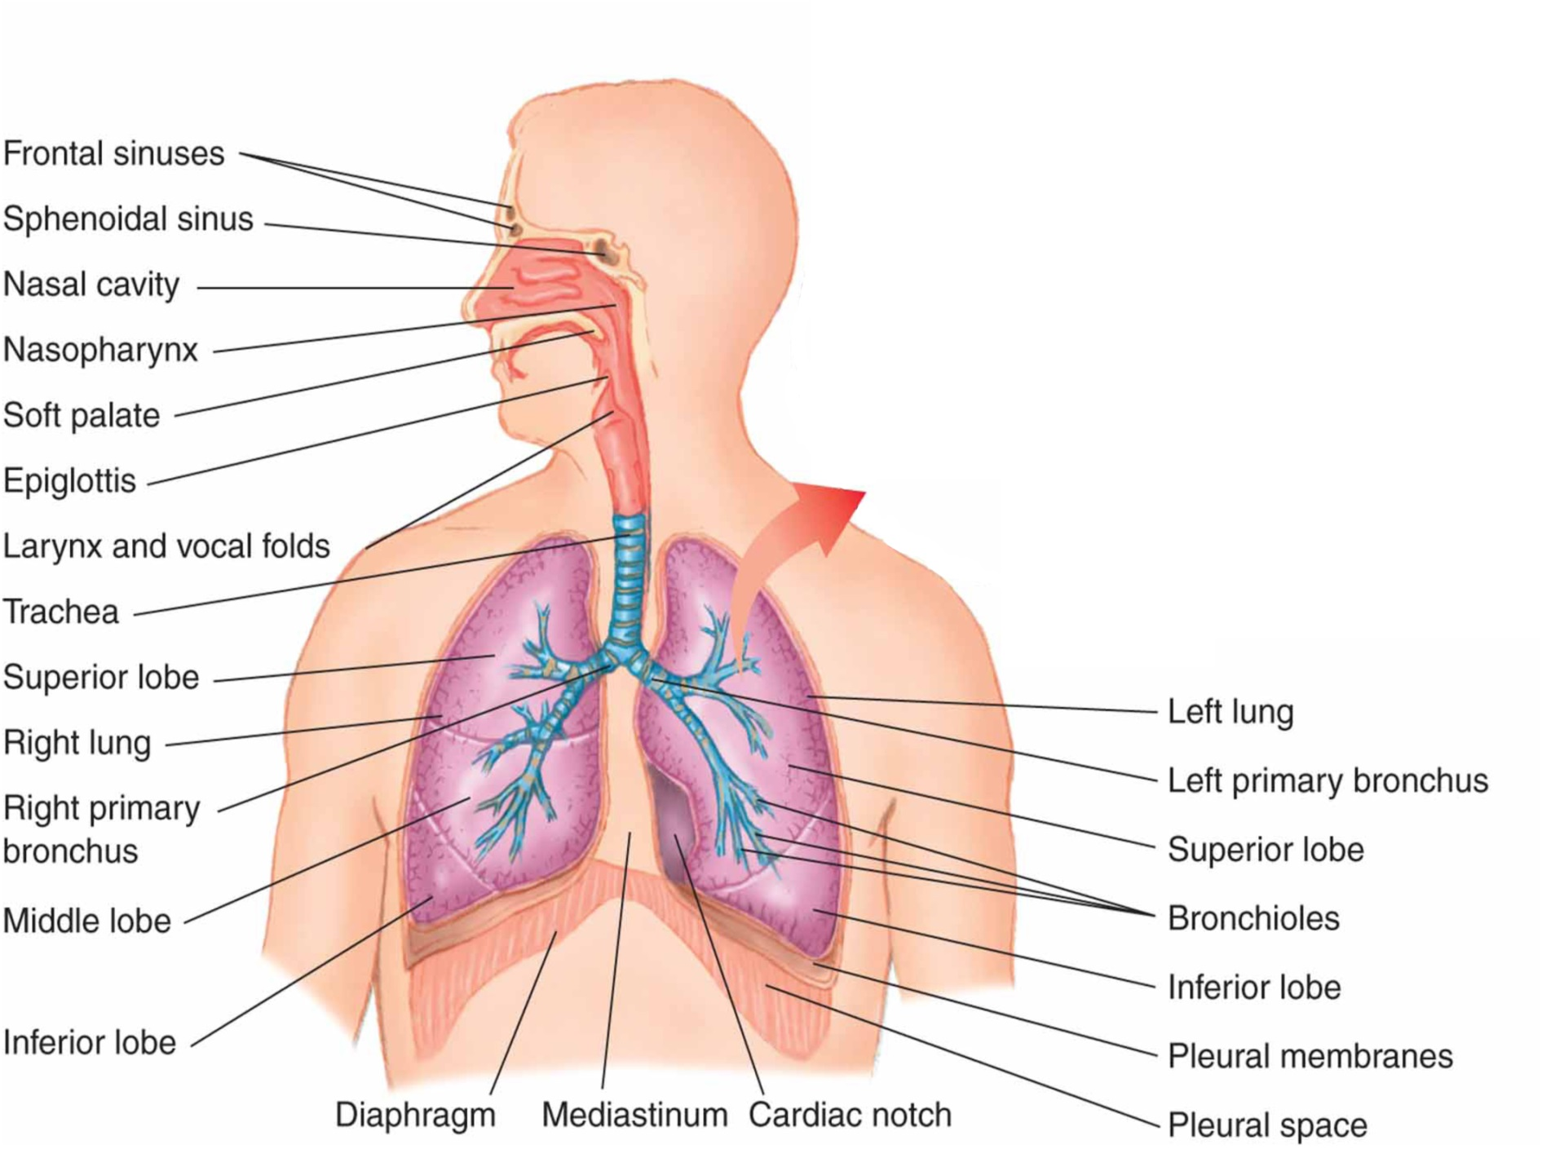
Patency of the Airway
Patency
Obstruction
  Nasopharynx
  Oropharynx
  posterior pharynx,
  Epiglottis
  Larynx
  Trachea
  bronchi.
Notes:
Talking Points
One of the most basic and important aspects of any emergency care provided at any level is to establish and maintain a patent airway.
A patent airway is one that is open and not obstructed by blood, secretions, vomitus, tissue, bone, teeth, or any other substance.
Establishing an open airway is one of the first steps in emergency care.
In some cases, it may be the only care necessary to treat the patient in the prehospital setting.
Failure to recognize, establish, or maintain a patent airway will lead to reduced oxygen concentration, cellular hypoxia, and eventual patient death.
An airway obstruction can occur at several anatomical levels in both the upper and lower the airway, including the nasopharynx, oropharynx, posterior pharynx, epiglottis, larynx, trachea, and bronchi.
36

Slide 37
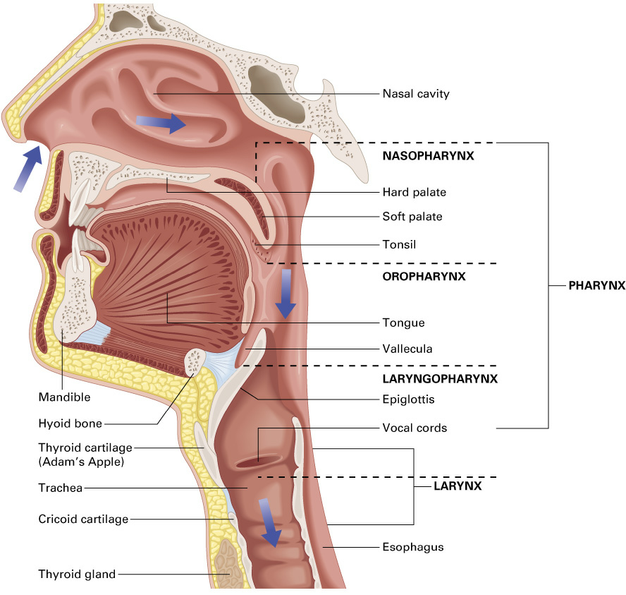
Patency of the Airway
Nasopharynx
Alternative airway location
  if fractured mandible or clenched teeth, can be used as an alternative location to establish an airway.
Usually does not pose a major problem
  Blood
  Secretions
  Vomitus
  tissue swelling
  bone fragments
  other substances.
Can lead to aspiration
  Blood, vomitus, or other substances may drain into the pharynx and lead to aspiration or occlusion.
Notes:
Talking Points
An obstruction may occur to the nasopharynx from blood, secretions, vomitus, tissue swelling, bone fragments, or other substances.
This usually does not pose a major airway problem if the oropharynx remains clear.
However, the nasopharynx opens into the pharynx which leads to the larynx, the trachea, and eventually the lungs. Blood, vomitus, or other substances that occlude the nasopharynx may drain into the pharynx and lead to aspiration or occlusion.
Thus, it is important to keep the nasopharynx clear to prevent potential aspiration.
In addition, if you are unable to gain access to the oropharynx because of a fractured mandible or clenched teeth, the nasopharynx can be used as an alternative location to establish an airway.
37

Slide 38
Patency of the Airway
Oropharynx and Pharynx
Blockage of airflow or aspiration of liquids will result in decreased alveolar oxygenation and a reduced delivery of oxygen to cells, leading to cellular hypoxia
Any obstruction must be removed immediately.
Liquid substances can easily be aspirated
Notes:
Talking Points
The oropharynx and pharynx can be obstructed by the tongue, foreign bodies, tissue swelling, hematomas, blood, vomitus, and other substances.
Any obstruction must be removed immediately.
Liquid substances such as blood or vomitus can easily be aspirated (breathed into the lungs) from the oropharynx and pharynx.
Aspirated substances like vomitus may damage the lung tissue or fill the alveoli and interfere with gas exchange.
Blockage of airflow in the oropharynx and pharynx or aspiration of liquid substances will lead to a decreased alveolar oxygenation and a reduced delivery of oxygen to cells, leading to cellular hypoxia.
38

Slide 39
Patency of the Airway
Epiglottis
Can occlude airway at the level of larynx
  injured/swelling
  inflamed from infection
May be helped by jaw-thrust or chin-lift
Notes:
Talking Points
The epiglottis is a flap of cartilaginous tissue that covers the opening of the larynx, known as the glottic opening, during swallowing.
If the epiglottis is injured and swells or becomes inflamed from infection, it can occlude the airway at the level of larynx.
The epiglottis is flexible tissue; thus, it may fall over the glottic opening when the muscles controlling the tongue relax and become flaccid.
A jaw-thrust or chin-lift maneuver is designed to lift the epiglottis clear of the glottic opening.
If there is obstruction from swelling or inflammation, advanced airway management may be required to establish a patent airway.
39

Slide 40
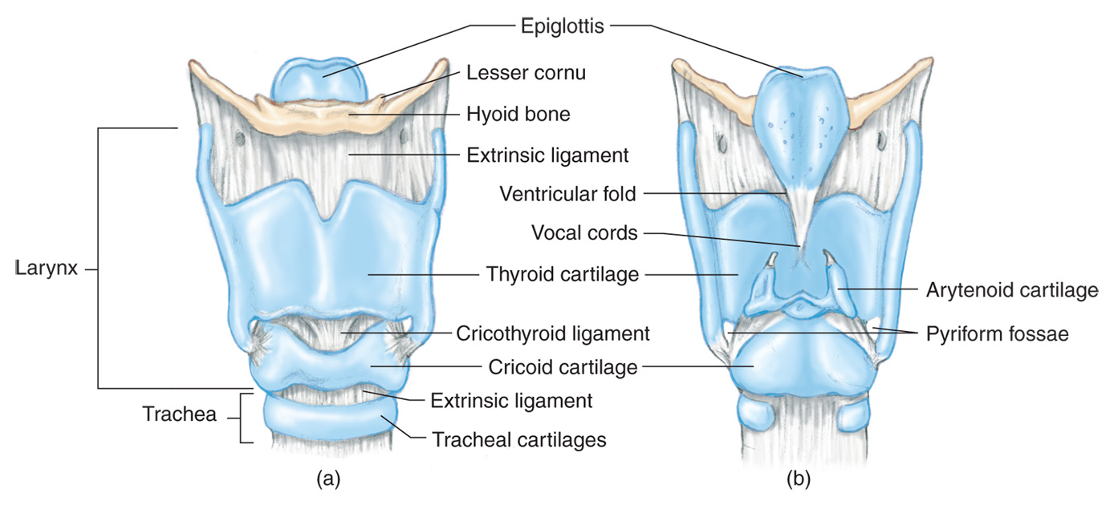
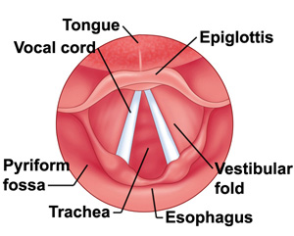
Patency of the Airway - Larynx
Thyroid cartilage
Cricoid cartilage
Laryngeal spasm
Notes:
Talking Points
The larynx is the structure that contains the vocal cords.
The anterior portion is comprised of the thyroid cartilage, which is the prominent “Adam’s apple” often seen in males.
The most inferior portion is the cricoid cartilage, a completely circumferential cartilaginous ring.
The larynx can be obstructed by laryngeal spasm, where the vocal cords spasm and close together, which prevents any air from passing into the trachea. This may result from injury, insertion of mechanical airways, or administration of some medications.
A fracture to the larynx may cause the laryngeal structures to lose stability and be drawn inward, creating an obstruction.
Any obstruction at the level of the larynx will prevent airflow into the trachea and lungs, leading to a reduced amount of oxygen in the alveoli and resulting in poor oxygen levels in the blood and cellular hypoxia.
40

Slide 41
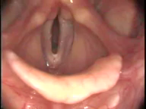
Vocal Cords

Slide 42
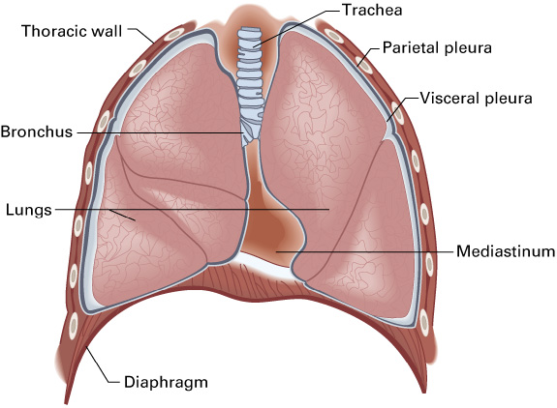
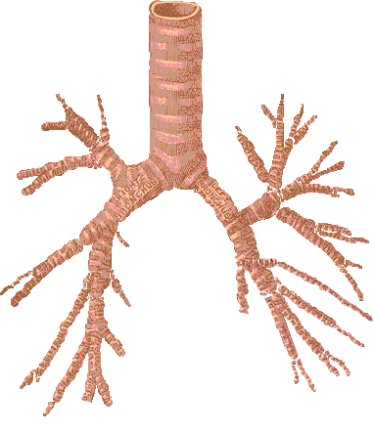
Patency of the Airway Trachea and Bronchi
Carina
Right and left mainstem
Notes:
Talking Points
The larynx opens into the trachea, which extends downward and bifurcates at the carina.
The carina is located at the second intercostal space (Angle of Louis) anteriorly or the fourth thoracic vertebra posteriorly.
The trachea is comprised of anterior cartilaginous rings that are C-shaped with a soft, flexible muscle on the posterior aspect.
The trachea bifurcates into the right mainstem bronchus and left mainstem bronchus.
Obstruction of the trachea and bronchi by secretions, blood, vomitus, food particles, objects, tissue, swelling, bone, or other substances block airflow to the bronchioles, which supply the alveoli with oxygenated air. This will reduce the concentration of oxygen in the alveoli, which in turn will reduce gas exchange and the amount of oxygen transported by the blood to the cells, leading to cellular hypoxia.
42

Slide 43
Respiratory Compromise Associated with Mechanics of Ventilation
Boyle’s Law Applied to Ventilation
Volume of a gas is
inversely proportional to the pressure
Air moves from an area of higher pressure to an area of lower pressure.
Notes:
Talking Points
The thoracic cavity must be intact to produce the changes in pressure needed for air to move in and out of the lungs.
Air moves from an area of higher pressure to an area of lower pressure.
As the size of the thorax increases, the pressure within it decreases, causing air to flow into the lungs.
When the thorax relaxes and decreases in volume, the pressure within it becomes higher, and air flows out of the lungs.
43

Slide 44
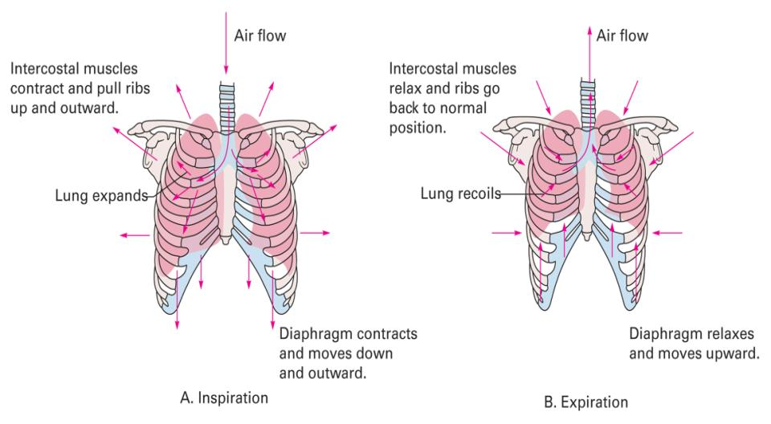
Active inhalation
Passive exhalation
Notes:
Talking Points
Ventilation is a mechanical process that relies on changes in pressure inside the thorax to move air in and out of the lungs. The alterations in pressure occur as a result of changes to the size of the thorax.
Ventilation conforms to Boyle’s law, which states that the volume of gas is inversely proportionate to the pressure. An increase in pressure (more positive) will decrease the volume of gas. A decrease in pressure (more negative) will increase the volume of gas.
During active inhalation, the diaphragm and external intercostals contract, the thorax increases in size and a negative pressure is created in the chest.
Normal atmospheric pressure is 760 mmHg at sea level. When the thorax expands, the pressure inside the chest drops to 758 mmHg.
In accordance with Boyle’s law, this negative pressure causes air to rush into the chest and the volume of air inside the chest to increase.
After inhalation, the diaphragm and external intercostals relax, passive exhalation occurs, the chest decreases in size and the pressure inside increases to about 761 mmHg which causes air to be forced out of the lungs.
44

Slide 45
Respiratory Compromise Associated with Mechanics of Ventilation
Accessory Muscles
Notes:
Talking Points
In addition to the diaphragm and intercostal muscles normally used for inhalation, there are a number of accessory muscles that can be used, especially during times of breathing difficulty.
These accessory muscles may be required either to help increase the chest size (to draw more air into the chest and lungs) or to help decrease the chest size (to force air out of the lungs and chest).
45

Slide 46
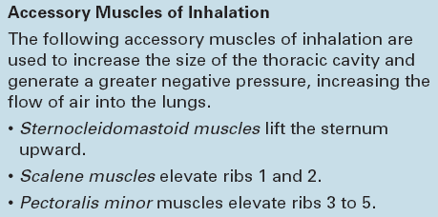
Accessory Muscles of Inhalation
Very energy intensive
Will compound respiratory problems
Notes:
Talking Points
Contracting the accessory muscles uses more energy than normal.
Keep in mind that adequate amounts of oxygen must be constantly delivered to the cells to produce energy.
A patient who needs to use accessory muscles to inhale may already be experiencing a lack of oxygen delivery and energy production.
If the patient lacks the energy needed to contract both regular and accessory muscles of inhalation, the respiratory muscles will begin to fail.
This will result in inadequate ventilation, which will compound the patient’s problems with a further decrease in oxygen delivery to cells.
46

Slide 47
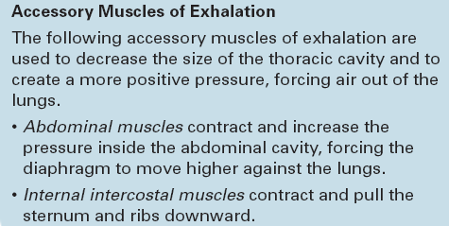
Accessory Muscles of Exhalation
Normally passive but can become active
Active requires energy
Can fatigue respiratory muscles quickly
Notes:
Talking Points
Exhalation is normally a passive process, requiring no expenditure of energy.
If the patient is struggling to expel air from the lungs, he may use the accessory muscles of exhalation to create more positive pressure in the chest.
If the accessory muscles are used, exhalation now becomes an active process, requiring energy.
If the patient is also using accessory muscles and additional energy to inhale, the extra energy needed for exhalation may cause the respiratory muscles to fatigue, leading to respiratory failure.
47

Slide 48
Respiratory Compromise Associated with Mechanics of Ventilation
Compliance and Airway Resistance
Notes:
Point to Emphasize
An increase in airway resistance or decrease in lung compliance can interfere with ventilation.
48

Slide 49
Two conditions which may require the use of accessory muscles
Compliance
  A measure of the ability of the chest wall and lungs to stretch, distend, and expand.
  A decrease in compliance = Greater Difficulty to breathe/Ventilate
Airway resistance
  The ease of air flow down the airway structures leading to the alveoli.
  A higher resistance = more difficulty moving air through the airways
Notes:
Talking Points
Two conditions that may require the use of accessory muscles are:
Compliance is a measure of the ability of the chest wall and lungs to stretch, distend, and expand. A decrease in compliance would make it more difficult for the patient to move air in and out of the lungs and more difficult for you to ventilate the patient. Pneumonia and pulmonary edema will decrease compliance within the lungs and structural problems like a flail segment will affect the ability of the chest muscles to contract.
Airway resistance is related to the ease of air flow down the conduit of airway structures leading to the alveoli. A higher airway resistance makes it more difficult to move air through the conducting airways; a lower airway resistance makes it easier to move air. Higher airway resistance requires the patient to work harder to breathe, expending more energy and possibly using accessory muscles, which may accelerate respiratory muscle fatigue and failure. The most common causes are edema within the airway structure, but mucus and constriction of the bronchioles will also decrease the radius of the airway and increase resistance.

Slide 50
Respiratory Compromise Associated with Mechanics of Ventilation
Pleural Space
Notes:
50

Slide 51
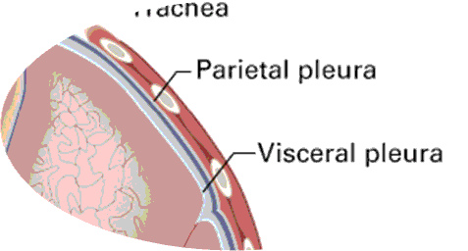
Notes:
Talking Points
The pleural space (space between the pleura) maintains a negative pressure.
If a break occurs in the continuity of either the parietal pleura from an open wound to the thorax or to the visceral pleura from an injury to the lung tissue, the negative pressure will draw air into the pleural space.
With each inhalation, the thorax increases its size and the pleural pressure becomes more negative.
This draws even more air into the pleural space, increasing its volume and collapsing the lung.
Lung collapse severely interferes with the ability of the alveoli to fill with air and to create an interface with the pulmonary capillaries, reducing gas exchange with the blood and leading to hypoxia.
This is why occluding any open wound to the chest is done very early in the primary assessment of a patient.
51

Slide 52
Respiratory Compromise Associated with Mechanics of Ventilation
Minute Ventilation
Notes:
Critical Thinking Discussion
Will applying oxygen by a nonrebreather mask improve tidal volume? Why or why not?
Points to Emphasize
Minute volume is the respiratory rate multiplied by the volume of air moved in and out of the lungs with each breath.
An average tidal volume of 500 mL and a respiratory rate of 12 per minute produces a tidal volume of 6,000 mL/minute, or 6 L/minute.
Any change in tidal volume or respiratory rate will change the minute volume.
Teaching Tip
Give several examples of how changing the tidal volume and respiratory rate change the minute volume.
52

Slide 53
Minute Ventilation
Minute Ventilation | The amount of air moved in and out of the lungs in one minute
Tidal Volume | The volume of air inhaled with each breath
Frequency | The number of ventilations in one minute
Minute Ventilation = Tidal Volume (V_{T}) x Frequency (f/min)
In an average adult, tidal volume (VT) is ~ 500 mL and frequency is ~ 12 breaths per minute
MV = 500mL x 12/min = 6,000 mL/min or 6 L/min
Notes:
Talking Points
Minute ventilation is the amount of air moved in and out of the lungs in one minute and is calculated by multiplying the tidal volume by the frequency of ventilation in one minute.
Tidal volume (V_{T}) is the volume of air breathed in with each individual breath and frequency of ventilation (f) is the number of ventilations in one minute.
Minute Ventilation = tidal volume (V_{T}) × frequency (f/minute)
An average-sized adult has a tidal volume of approximately 500 mL and breathes approximately 12 times per minute at rest. So, minute ventilation = 500 mL× 12/minute = 6,000 mL/minute or 6 L/minute
You won’t calculate the minute ventilation in field. However, understand that:
A decrease in tidal volume will decrease the minute ventilation.
A decrease in frequency of ventilation will decrease the minute ventilation.
A decrease in minute ventilation will reduce the amount of air available for gas exchange in the alveoli.
A decrease in minute ventilation can lead to cellular hypoxia.
To ensure adequate ventilation, the patient must have both an adequate tidal volume and an adequate rate of ventilation.
53

Slide 54
NOTE:
A in tidal volume will decrease the minute ventilation.
A in frequency of ventilation will decrease the minute ventilation.
A in minute ventilation will reduce the amount of air available for gas exchange in the alveoli.
A in minute ventilation can lead to cellular hypoxia.
To ensure adequate ventilation, the patient must have both an adequate tidal volume and an adequate rate of ventilation.

Slide 55
Respiratory Compromise Associated with Mechanics of Ventilation
Alveolar Ventilation
(amount of air moved in and out of the alveoli in one minute)
A low tidal volume will decrease the alveolar ventilation by not putting enough air into the alveoli with each breath.
A ventilatory rate that is too slow or too fast will not provide enough air in the alveoli for adequate gas exchange.
Notes:
Talking Points
Understanding minute ventilation and alveolar ventilation should help you understand the relationship between the tidal volume and ventilatory rate.
A low tidal volume will decrease the alveolar ventilation by not putting enough air into the alveoli with each breath.
A ventilatory rate that is too slow or too fast will not provide enough air in the alveoli for adequate gas exchange.
Teaching Tip
Ask students to breathe normally through a drinking straw to demonstrate the effect of dead air space on alveolar ventilation.
Discussion Question
How do patients compensate for a condition that decreases tidal volume?
Knowledge Application
Given several scenarios including a patient’s respiratory rate and tidal volume, determine if the patient’s alveolar ventilation is likely to be adequate or inadequate.
55

Slide 56
Alveolar ventilation
V_{T} (tidal volume) – V_{D} (dead air space ) X breaths/min
V_{D} = approx. 150 mL
(500 mL–150 mL) x 12/min = 4,200mL (4.2 L/min.)
Key Points
  The patient may breathe faster to move more air in/out but that does not mean he is getting more oxygen into the alveoli for gas exchange.
  To improve gas exchange provide PPV
  Placing a patient on oxygen will not improve ventilation
  Assessing tidal volume is as important as assessing the ventilatory rate.
Notes:
Talking Points
Alveolar ventilation is the amount of air moved in and out of the alveoli in one minute. The key to this definition is specifically the amount of air moving in and out of the alveoli. Anatomic dead air space is an important concept here.
Dead air space (V_{D}) consists of anatomic areas in the respiratory tract where air collects during inhalation but no gas exchange occurs. The air that moves in and out of these areas is not involved in gas exchange and is wasted.
In an average adult, approximately 150 mL of the tidal volume is lost in the dead air space. If 500 mL of air breathed in, only 350 mL reaches the alveoli.
The equation for alveolar ventilation = V_{T} (tidal volume) – V_{D} (dead air space V_{D} ) x frequency of ventilation/min.
An average adult in the same scenario would be calculated as follows: alveolar ventilation = (500 mL–150 mL) x 12/min = 4,200mL or 4.2 L/min.
The key points to consider with alveolar ventilation are:
– The patient may begin to breathe faster to move more air in / out but that does not mean he is getting more oxygen into the alveoli for gas exchange.
– To improve gas exchange provide positive pressure ventilation
– Simply placing a patient on oxygen will not improve ventilation
– Assessing tidal volume is as important as assessing the ventilatory rate.
56

Slide 57
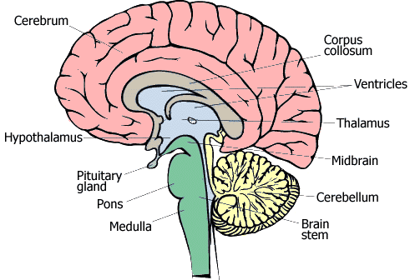
Regulation of Ventilation
Chemoreceptors
Central (Hypercapnic/hypercarbic) Drive
  Near the respiratory center in the medulla
  Most sensitive to changes in carbon dioxide and pH (acid) (>CO2 = >acid
Peripheral (Hypoxic Drive)
  In the aortic arch and
  the carotid bodies
  Primarily sensitive to
  the level of oxygen
Notes:
Talking Points
The central chemoreceptors are located, and are most sensitive to changes in carbon dioxide and pH (acid).
Carbon dioxide and pH are related in that the more CO₂ in the blood, the greater the amount of acid, and the less CO₂ in the blood, the less amount of acid.
Even very small changes in CO₂ and pH will stimulate changes in rate and depth of breathing. Faster, deeper breathing blows off more CO₂ and slower, shallower breathing blows off less CO₂.
The peripheral chemoreceptors are located in the aortic arch and the carotid bodies. These chemoreceptors are also somewhat sensitive to CO₂ and pH but primarily sensitive to the level of oxygen in the arterial blood.
As the blood oxygen levels fall, the peripheral chemoreceptors signal the respiratory center in the brainstem to increase rate and depth of respiration.
It takes a significant decrease in the arterial oxygen content to trigger the peripheral chemoreceptors to stimulate the respiratory center. Therefore, our primary drive to breathe comes from the action of the central chemoreceptors.
57

Slide 58
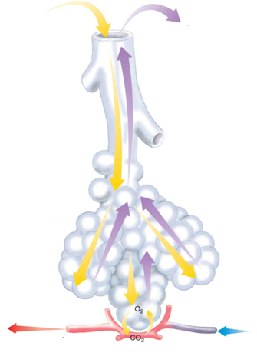
Regulation of Ventilation
Chemoreceptors
Hypercarbic drive
  Rate and depth of breathing are regulated primarily by the amount of
  carbon dioxide in the blood
Hypoxic drive
  Rate and depth of breathing
  are regulated primarily
  decreases in the oxygen level
Notes:
Talking Points
A person’s rate and depth of breathing are regulated primarily by the amount of carbon dioxide in the blood. This is referred to as hypercarbic drive.
This situation may be altered for patients with chronic obstructive pulmonary disease (COPD), such as emphysema. Because these patients tend to chronically retain carbon dioxide in arterial blood as a result of their poor gas exchange, their central chemoreceptors often become insensitive to the small changes that typically stimulate ventilation.
Because of that, the peripheral chemoreceptors often take over as the primary stimulus for ventilation. Thus, instead of a small increase in CO₂ being a the stimulus for ventilation, the body now relies on decreases in the oxygen level to stimulate ventilation.
Hypoxia becomes the stimulus for ventilation in place of hypercarbia. This is known as hypoxic drive.
58

Slide 59
Regulation of Ventilation
Lung Receptors

Slide 60
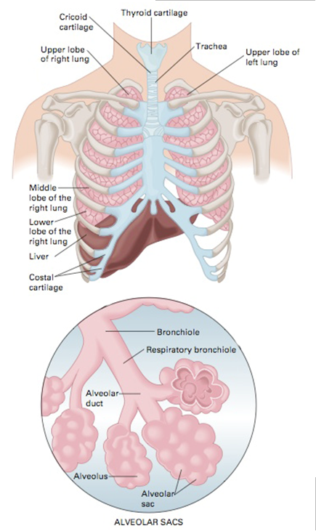
Regulation of Ventilation
Lung Receptors
Irritant receptors
  Sensitive to
    Irritating gases
    Aerosols
    Particles
  Irritant receptors stimulate
    Cough
    Bronchoconstriction
    Increased ventilatory rate
Stretch receptors
  Found in smooth muscle of airways
  Measure the size and volume of the lungs
  Stimulate a decrease in rate and volume when stretched
  Protect against lung over inflation
J-receptors
  Found in the capillaries surrounding the alveoli
  Sensitive to increases in pressure in the capillary
  When activated, the
  J-receptors stimulate rapid, shallow ventilation
Irritant receptors
Stretch receptors
J-receptors
Notes:
Talking Points
There are three types of receptors within the lungs that provide impulses to regulate respiration:
Irritant receptors are found in the airways and are sensitive to irritating gases, aerosols, and particles. Irritant receptors will stimulate a cough, bronchoconstriction, and an increased ventilatory rate.
Stretch receptors are found in the smooth muscle of the airways and measure the size and volume of the lungs. These receptors stimulate a decrease in the rate and volume of ventilation when stretched by high tidal volumes to protect against lung over inflation.
J-receptors are found in the capillaries surrounding the alveoli and are sensitive to increases in pressure in the capillary. When activated, the J-receptors stimulate rapid, shallow ventilation.
60

Slide 61
Regulation of Ventilation
Respiratory Centers in the Brainstem
Notes:
Discussion Question
How can an injury to the brain interfere with perfusion?
Critical Thinking Discussion
You’ve just been scared by a near-collision as you are driving to class. Explain how your perfusion will be affected.
Point to Emphasize
Four groups of neurons in the brainstem control the depth and pattern of ventilation.

Slide 62
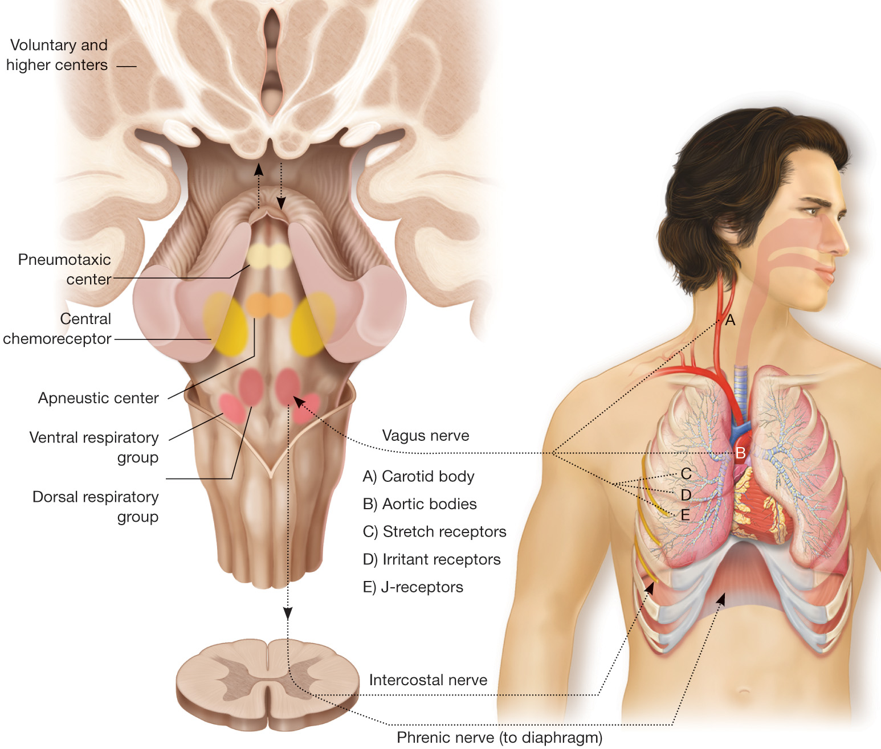
Respiratory Centers in the Brainstem
Dorsal respiratory group (DRG)
Ventral respiratory group (VRG)
Apneustic center
Pneumotaxic center
(Cont)
Notes:
Talking Points
The dorsal respiratory group (DRG) facilitates inhalation by telling the external intercostal muscles and the diaphragm to contract. The DRG functions in every respiratory cycle, whether during quiet breathing or during forced breathing with the accessory muscles involved.
The ventral respiratory group (VRG) has both inspiratory and expiratory neurons and is basically inactive during regular quiet ventilation. The VRG becomes active when an increase in ventilatory effort is necessary to control accessory muscles like the pectoralis, sternocleidomastoid muscles, internal intercostal and abdominal muscles.
The apneustic center provides stimulation to the DRG and VRG to intensify inhalation. It may prolong inspiration to increase ventilation volume.
The pneumotaxic center sends inhibitory impulses to the apneustic center to turn off inhalation before the lungs are too full.
62

Slide 63
Dorsal respiratory group (DRG)
  Facilitates inhalation by telling the external intercostal muscles and the diaphragm to contract.
  Functions in every respiratory cycle
Ventral respiratory group (VRG)
  Both inspiratory and expiratory neurons
  Basically inactive during regular quiet ventilation.
  Becomes active when an increase in ventilatory effort is necessary
(Cont)

Slide 64
The apneustic center
  Provides stimulation to the DRG and VRG to intensify inhalation.
  May prolong inspiration to increase ventilation volume.
The pneumotaxic center
  Sends inhibitory impulses to the apneustic center to turn off inhalation before the lungs are too full.

Slide 65
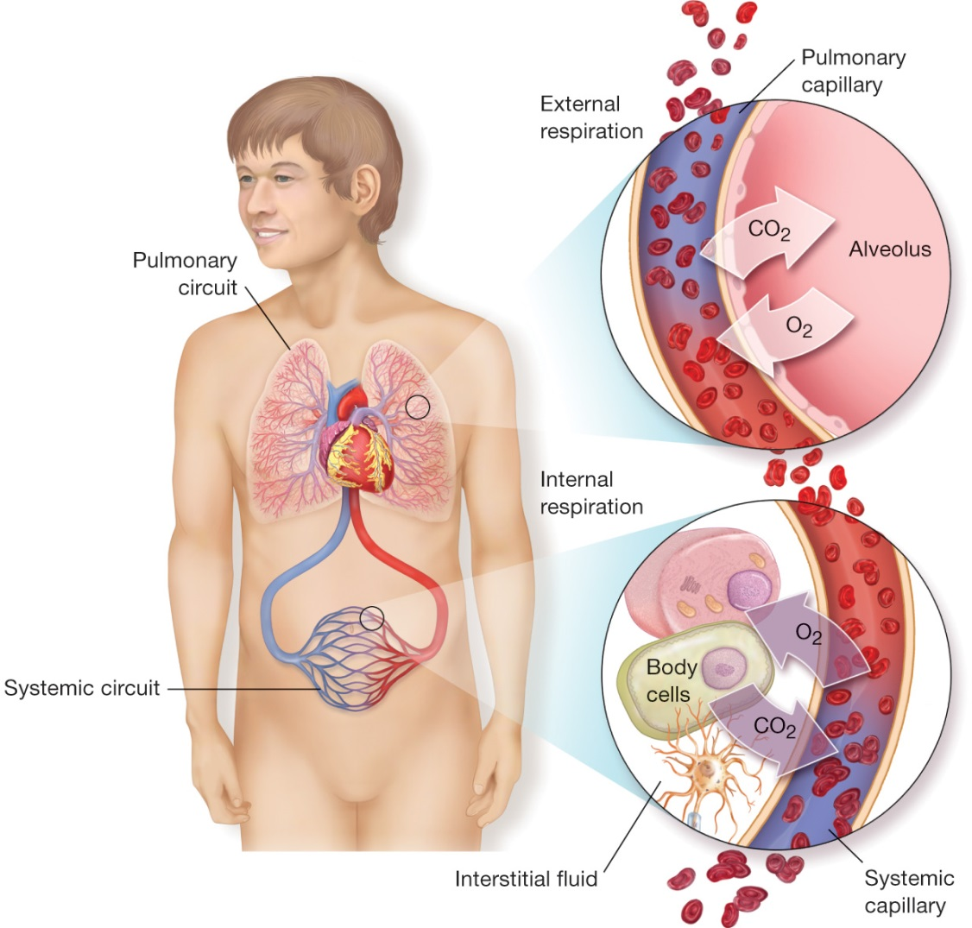
Ventilation / Perfusion
(V/Q) Ratio
Describes the relationship between the amount of ventilation the alveoli receive
<and >
The amount of perfusion through the capillaries surrounding the alveoli.
Notes:
Talking Points
The ventilation/perfusion (V/Q) ratio describes the dynamic relationship between the amount of ventilation the alveoli receive and the amount of perfusion through the capillaries surrounding the alveoli.
This relationship determines the quality of gas exchange across the alveolar-capillary membrane, which influences the amount of oxygen entering the blood and the amount of carbon dioxide exiting the blood.
The dynamic relationship between ventilation and perfusion in the lungs can be used to explain the etiology (causes) of hypoxemia, or inadequate oxygen concentrations in the blood.
A ventilation/perfusion mismatch leads to decreased gas exchange between the alveoli and alveolar capillaries.
Discussion Question
What is the concept of the ventilation/perfusion ratio?
65

Slide 66
V/Q Ratio
Apexes:
  Available ventilation in the alveoli exceeds the amount of perfusion through the pulmonary capillaries
  V/Q > 1; This is considered to be wasted ventilation.
Bases:
  Amount of perfusion exceeds the amount of ventilation
  V/Q < 1; This is considered to be wasted perfusion.
(Cont)

Slide 67
Ideal: V/Q = 1
  Each alveolus would receive an adequate amount of ventilation and a matching amount of blood flow through the surrounding capillary,
The V/Q ratio is never at an ideal state in any zone of the lungs.
  Overall, under normal conditions, perfusion exceeds the amount of available ventilation.
    V/Q = <1
  Typical V= ~4Lpm air; Q = 5Lpm blood
    V/Q = .8

Slide 68
Ventilation/Perfusion Ratio
Pressure Imbalances
Notes:
Point to Emphasize
Respiratory gases move from areas of high concentration to areas of low concentration.
68

Slide 69
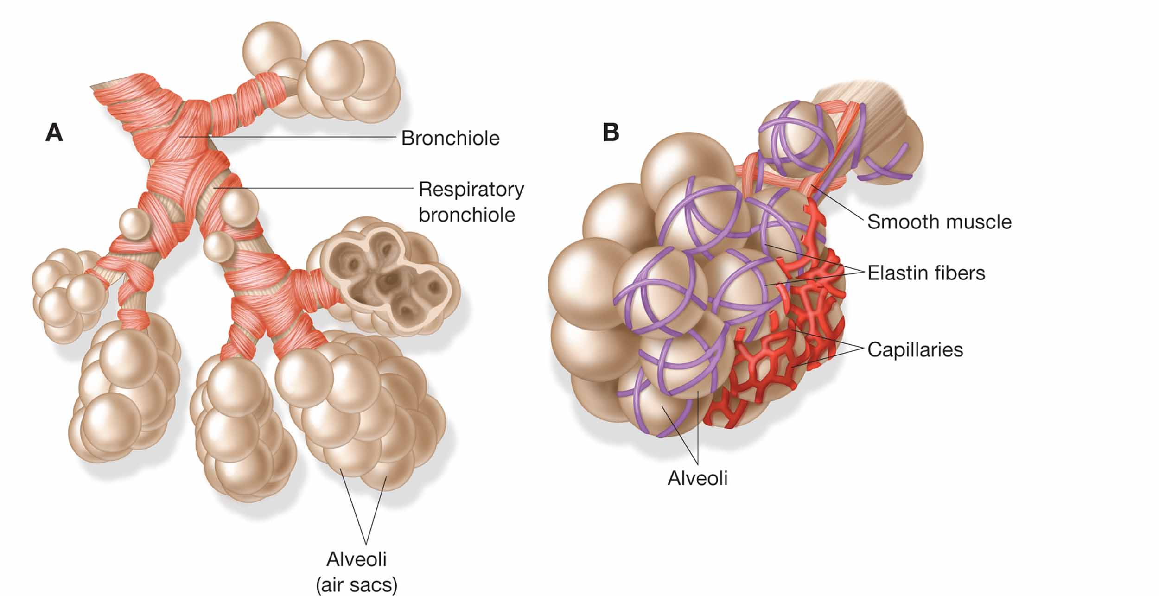
Perfusion of blood though the pulmonary capillaries is affected by
  Amount of air and pressure inside the alveoli
  Pressure of blood flowing through the
  capillary bed.
(Cont)
Notes:
Talking Points
The perfusion of blood though the pulmonary capillaries is affected by the amount of air and pressure inside the alveoli and the pressure of the blood flowing through the capillary bed.
If the pressure in an alveolus exceeds the blood pressure in the capillary bed, blood flow through the capillary stops.
This is most likely to occur in the apexes of the lungs where the pressure inside the alveoli is highest and the blood flow is lowest. However, it may also occur in the patient who is losing blood from an injury and has a decreasing blood pressure.
A decrease in the systemic blood pressure will cause the pressure in the pulmonary capillaries to decrease also.
69

Slide 70
If pressure in an alveolus exceeds the blood pressure in the capillary bed, blood flow stops.
  Most likely to occur in the apexes of lungs where the pressure inside the alveoli is highest and the blood flow is lowest
  May also occur in the patient who is losing blood from an injury and has a decreasing blood pressure
    A decrease in systemic blood pressure will cause the pressure in the pulmonary capillaries to also decrease
Notes:
Talking Points
The perfusion of blood though the pulmonary capillaries is affected by the amount of air and pressure inside the alveoli and the pressure of the blood flowing through the capillary bed.
If the pressure in an alveolus exceeds the blood pressure in the capillary bed, blood flow through the capillary stops.
This is most likely to occur in the apexes of the lungs where the pressure inside the alveoli is highest and the blood flow is lowest. However, it may also occur in the patient who is losing blood from an injury and has a decreasing blood pressure.
A decrease in the systemic blood pressure will cause the pressure in the pulmonary capillaries to decrease also.

Slide 71
Ventilation/Perfusion Ratio
Ventilatory Disturbances
Notes:
71

Slide 72
Ventilation/Perfusion Ratio
Ventilatory Disturbances
Less oxygenated air available
  Can lead to hypoxia
Blood pressure in capillaries is not affected
Example V=3 Lpm; Q=5 Lpm
  V/Q= .6
EX: If from asthma, must relieve the bronchoconstriction and increase oxygenation.

Slide 73

Ventilation/Perfusion Ratio
Perfusion Disturbances
Often due to blood loss
Needs fluid replacement to resolve perfusion issues
Notes:
Talking Points
A perfusion disturbance, or blood loss, may lead to severe cellular hypoxia.
Consider a patient who has cut his radial artery and suffered severe blood loss. The patient has no chest or lung injury and has an increased rate and depth of ventilation. His minute ventilation and alveolar ventilation are increased, but his cells are becoming hypoxic. He is moving more oxygenated air into the alveoli but blood loss has significantly reduced the amount of blood flow through the pulmonary capillaries.
This represents a perfusion disturbance because there is not enough blood to pick up the oxygen available in the alveoli. Placing the patient on oxygen might reduce some of the cellular hypoxia but the bleeding must be stopped and this patient needs to receive fluid and blood to increase the flow and pressure in the pulmonary capillaries so that there is enough hemoglobin available for oxygen in the alveoli to attach to and be transported to the cells.
73

Slide 74
Transport of Oxygen and Carbon Dioxide by the Blood

Slide 75
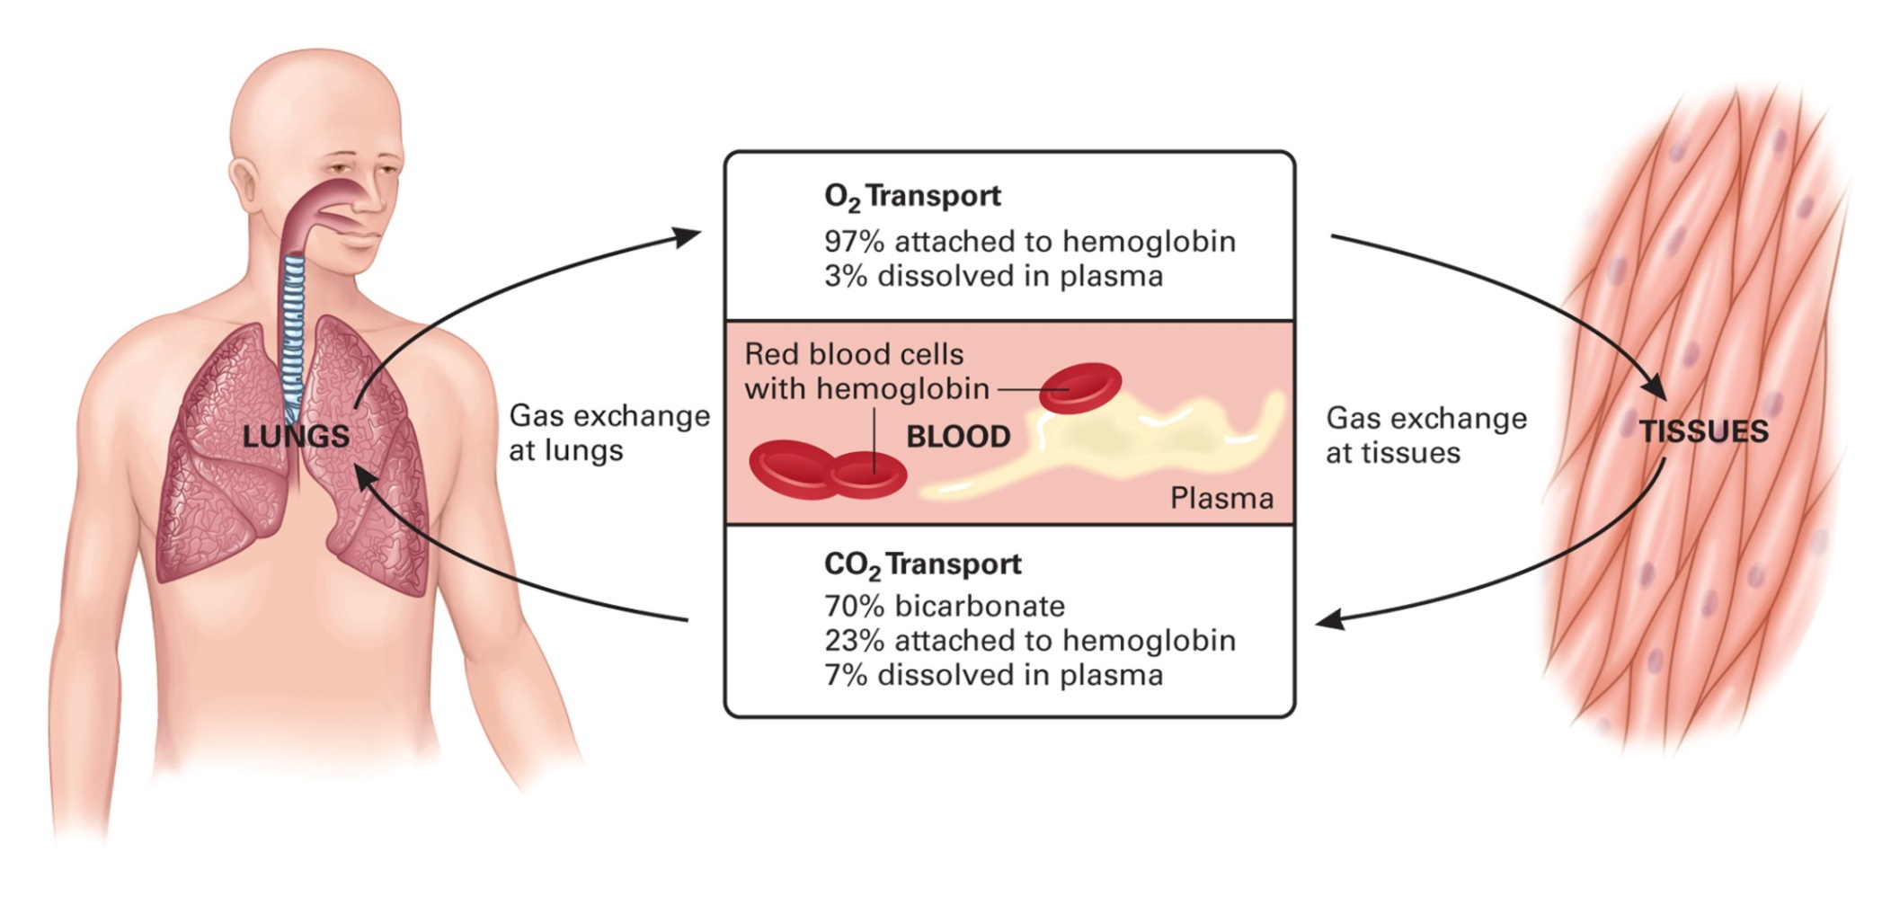
Cells need O₂ for normal cellular metabolism
Hypercarbia: build-up of CO₂ in the blood
Hypoxia: lack of O₂ available to the cells
Notes:
Talking Points
Oxygen must be continuously delivered by the blood to the cells in order for normal cellular metabolism to occur.
Carbon dioxide, a byproduct of aerobic metabolism, must be carried back to the lungs to be blown off in exhalation.
A disturbance in the transport system may lead both to cellular hypoxia, a lack of oxygen available to the cells, and to hypercarbia, a build-up of carbon dioxide in the blood.
Both hypoxia and hypercarbia pose problems for normal cellular function and stability.
Oxygen and carbon dioxide are transported by the blood in different ways, but they diffuse the same: from areas of higher concentration to areas of lower concentration.
75

Slide 76
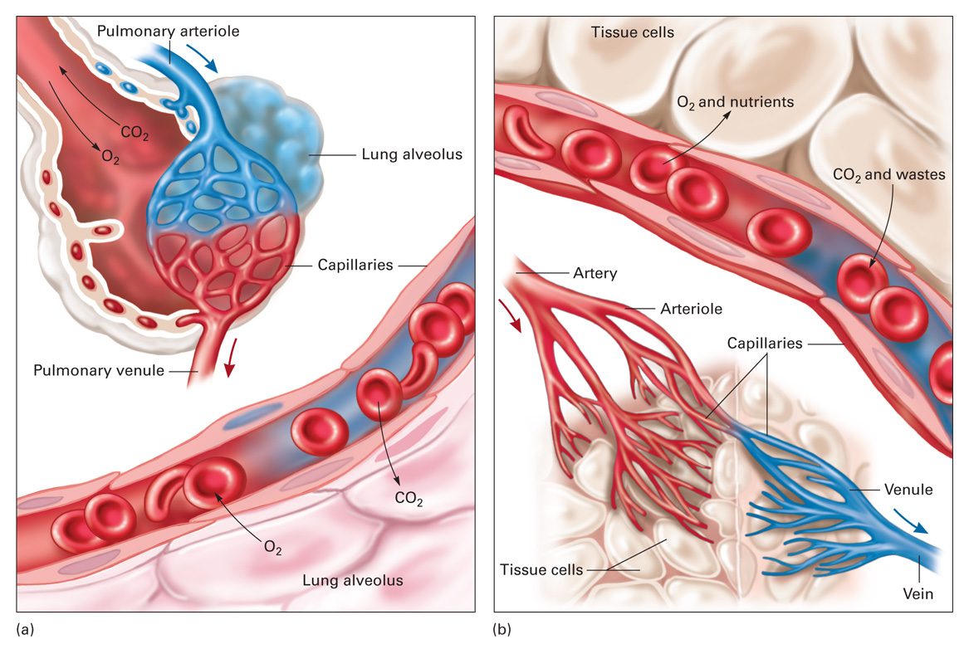
Transport of Oxygen in the Blood
Hemoglobin
  Protein molecule
  Oxygen has a high affinity to attach to it
Oxyhemoglobin
  With an oxygen molecule bound to it
Deoxyhemoglobin
  With no oxygen attached
Loss of hemoglobin
  Can lead to severe cellular hypoxia
Notes:
Talking Points
Hemoglobin is a protein molecule found in all red blood cells. It has four iron sites that oxygen has a high affinity for binding to. Thus, one hemoglobin molecule could carry up to four oxygen molecules. If one oxygen molecule is attached to the hemoglobin molecule, it is considered to have 25 percent saturation.
Oxyhemoglobin is hemoglobin with an oxygen molecule bound to it.
Deoxyhemoglobin is hemoglobin with no oxygen attached.
Without hemoglobin, the negligible amount of oxygen transported in plasma would not sustain life.
A loss of hemoglobin, which commonly occurs as a result of bleeding, can easily lead to severe cellular hypoxia, even if adequate oxygen is available.
76

Slide 77
Transport of Carbon Dioxide
in the blood
7%
  Dissolved in plasma
23%
  Attached to Hemoglobin
70%
  As Bicarbonate
Notes:
Talking Points
Carbon dioxide is transported in the blood in three ways
7 percent dissolved in plasma
23 percent attached to hemoglobin
70 percent in the form of bicarbonate
77

Slide 78
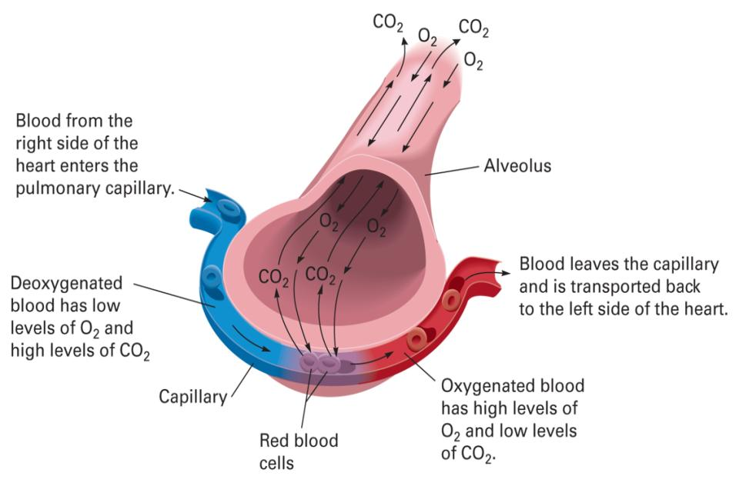
Transport of O₂ and CO₂ in the Blood
Alveolar/Capillary Gas Exchange
Notes:
Talking Points
After inhalation, alveoli are filled with oxygen-rich air and very little CO₂. Conversely, venous blood contains low levels of O₂ and high CO₂.
Since gases naturally move from an area of high concentration to an area of low concentration, the high O₂ in the alveoli moves across the membranes and into the capillaries where the O₂ content is very low.
Simultaneously, CO₂ moves in the opposite direction, from the high levels in the capillaries into the alveoli where the CO₂ is low. The bicarb ions in the blood convert to water and CO₂. Additional CO₂ diffuses out of the plasma and from the hemoglobin. All the CO₂ crosses from the capillaries into the alveoli.
Basically, the gases have switched concentrations. The carbon-dioxide-rich air in the alveoli is exhaled from the lungs. The oxygen-rich blood in the capillaries is transported from the pulmonary circulation to the left atrium and then to the left ventricle of the heart, from which it is ejected into the aorta and to the arteries throughout the body. This blood that is now circulating throughout the body is the blood that will be used in the cell/capillary gas exchange described next.

Slide 79
Transport of O₂ and CO₂ in the Blood
Cell/Capillary Gas Exchange
Notes:
Talking Points
During cell metabolism, the cells have used O₂ and produced CO₂ as a byproduct. Thus, while the capillary beds contain blood that is high in O₂ and low in CO₂, the cells contain low levels of O₂ and high levels of CO₂.
As blood enters the capillary, O₂ breaks free of the hemoglobin and diffuses out of the plasma, crosses the capillary membrane, and enters the cell.
Simultaneously, CO₂ leaves the cell and crosses over into the capillary where it dissolves in the plasma, attaches to hemoglobin, or enters the red blood cell to be converted to bicarbonate. As the blood leaves the capillary, it enters a small venule from which it is eventually dumped into a larger vein. The blood in the venules and veins contains low concentrations of O₂ and high concentrations of CO₂.
79

Slide 80
Blood Volume

Slide 81
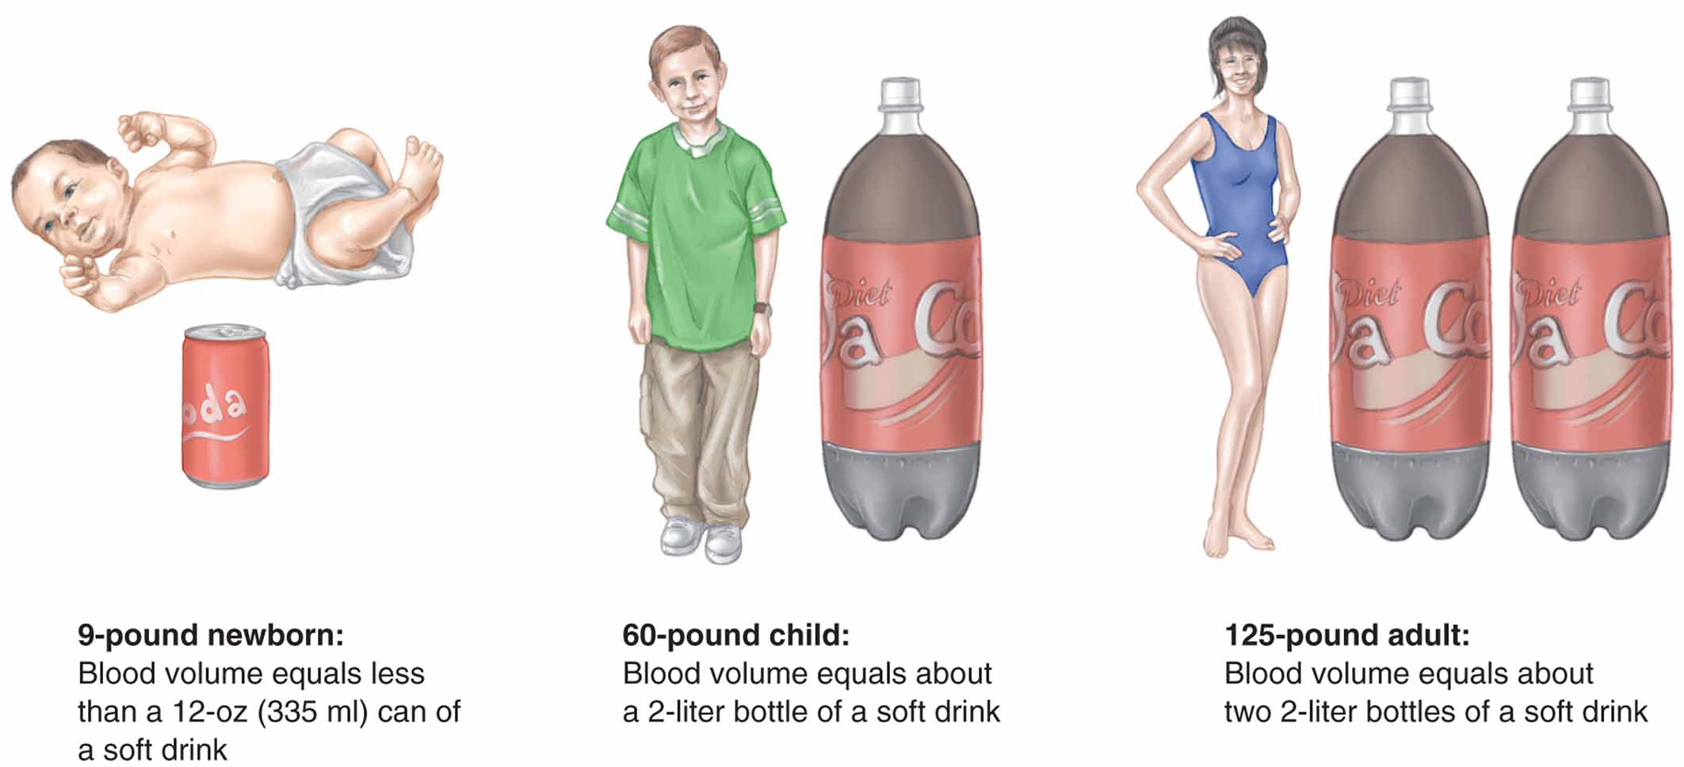
Can die from losing half to two-thirds of their Blood Volume
~335 ml
~2 L
~4 L
An adult has approx. 70mL of blood per kilogram.
(1 kg equals 2.2 pounds; 1 lb is equal to ~0.45kg)
(1 L ~ 1.057 qt @200 lb ~ 90.7 kg ~6.3 L ~6.7 qt)
Notes:
Talking Points
One of the determinants of an adequate blood pressure and perfusion is blood volume.
An adult has approximately 70 mL of blood for every kilogram (2.2 lbs) of body weight. Thus, a patient who weighs 154 lbs or 70 kg would have approximately 4,900 mL or 4.9 liters of blood volume.
Blood volume correlates with body mass; therefore, a larger patient would normally have a greater blood volume.
The loss of one liter of blood in a 100-pound patient would be much more significant than in a 200-pound patient.
81

Slide 82
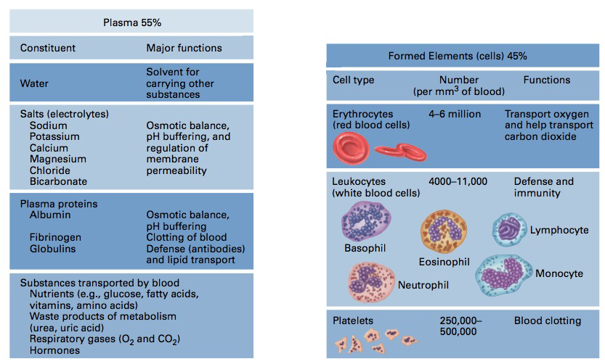
Composition of Blood
Notes:
Talking Points
Plasma is made up primarily of water and plasma proteins. Water comprises 91 percent of plasma. The plasma proteins consist of albumin, antibodies, and clotting factors. Albumin is a large molecule that does not pass easily through a capillary; it plays a major role in maintaining the fluid balance in the blood. Antibodies are produced by the lymphatic system and are responsible for the defense against infectious organisms. The clotting factors are key in coagulation of blood from damaged vessels. Fibrinogen is the most plentiful clotting factor and is the precursor to the fibrin clot.
The formed elements in the blood are red blood cells, white blood cells, and platelets. Red blood cells (erythrocytes) make up approximately 48 percent of the blood cell volume in men and 42 percent in women. The red blood cells, which contain hemoglobin, are primarily responsible for carrying oxygen and delivering it to cells for metabolism. The white blood cells (leukocytes) protect the body against infection and eliminate dead and injured cells and other debris. The platelets (thrombocytes) are not actual cells but fragments that play a major role in blood clotting and the control of bleeding.
82

Slide 83
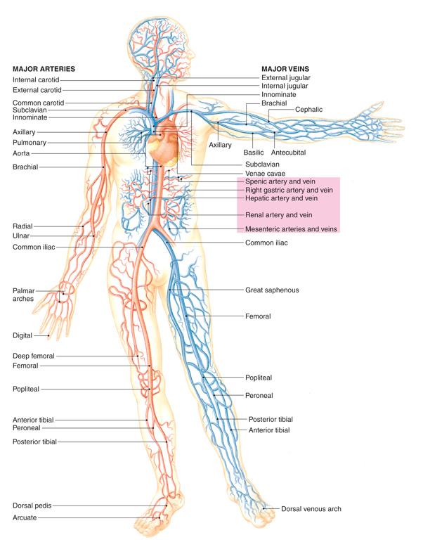
Distribution of Blood
Distributed throughout the cardiovascular system.
The majority of blood is housed within the venous system
  Also known as a reservoir or capacitance system
Notes:
Talking Points
The venous system is capable of enlarging or reducing its capacity to respond to increases or decreases in the blood volume. As a patient bleeds, the venous volume is continuously reduced regardless of whether the bleeding is from a vein, an artery, or a capillary.
The venous system is responsible for supplying the right side of the heart with an adequate volume of blood.
If the volume entering the right side of the heart is decreased, the amount ejected from the left ventricle, through the arteries and to the cells, is also reduced.
Thus, the venous volume plays a major role in maintaining blood pressure and adequate perfusion of the cells.
The capillary network is the site of gas exchange occurring with the alveoli or cells.
83

Slide 84
Blood Volume
Hydrostatic Pressure
The movement of fluid between the capillaries and the interstitial spaces is affected by hydrostatic pressure and plasma oncotic pressure.
Notes:
Point to Emphasize
The movement of fluid between the capillaries and the interstitial spaces is affected by hydrostatic pressure and plasma oncotic pressure.

Slide 85
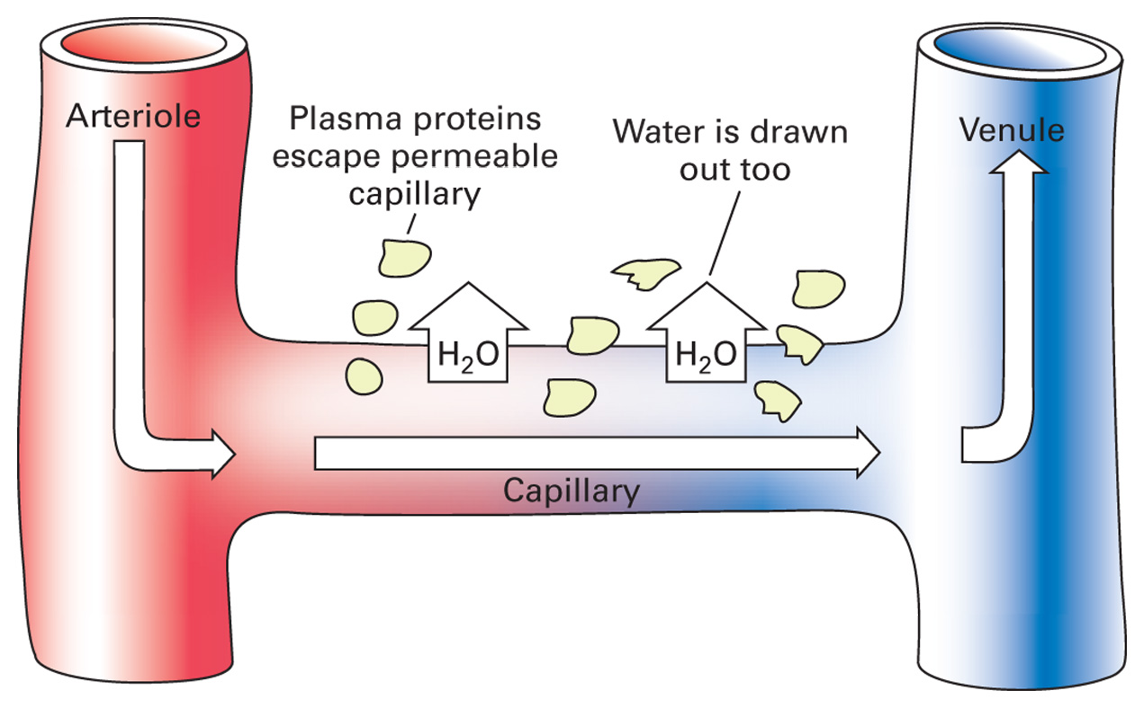
Hydrostatic Pressure
The force inside the vessel or capillary bed generated by the contraction of the heart and the blood pressure.
Notes:
Talking Points
Hydrostatic pressure is the force inside the vessel or capillary bed generated by the contraction of the heart and the blood pressure.
Hydrostatic pressure exerts a “push” inside the vessel or capillary; it naturally wants to push fluid out of the vessel or capillary, through the vessel wall, and into the interstitial space.
A high hydrostatic pressure would force more fluid out of the vessel or capillary and promote edema and swelling from excess fluid outside the vessels.
For example, if the left ventricle is failing and unable to pump blood effectively, the volume and pressure in the left atrium, pulmonary vein, and pulmonary capillaries rise. Blood backs up, pressure increases, and fluid is forced out of the pulmonary capillaries. The extruded fluid will collect in the spaces between the alveoli and capillaries, reducing the ability of oxygen and carbon dioxide to be exchanged. The fluid eventually collapses the alveoli, further diminishing gas exchange. This is known as pulmonary edema.
85

Slide 86
Example: Pulmonary Edema
If the left ventricle is failing and unable to pump blood effectively
  The volume and pressure in the left atrium, pulmonary vein, and capillaries rise.
  Blood backs up, pressure increases, and fluid is forced out of the pulmonary capillaries.
  The fluid will collect in the spaces between the alveoli and capillaries, reducing the ability of oxygen and carbon dioxide to be exchanged.
  The fluid eventually collapses the alveoli, further diminishing gas exchange.

Slide 87
Blood Volume
Plasma Oncotic Pressure
AKA: colloid oncotic pressure or oncotic pressure, is responsible for keeping fluid inside the vessels. (exerts a “pull” inside the vessel)
Notes:
Talking Points
Plasma oncotic pressure, also known as colloid oncotic pressure or oncotic pressure, is responsible for keeping fluid inside the vessels.
A force is generated inside vessels by large plasma proteins, especially albumin, that attract water and other fluids.
Opposite to hydrostatic pressure, oncotic pressure exerts a “pull” inside the vessel.
A high oncotic pressure pulls fluid from outside the vessel, through the vessel wall, and into the vessel.

Slide 88
Plasma Oncotic Pressure
High: draws excessive amounts of fluid into the vessel and promotes blood volume overload.
Low: does not counteract the push of hydrostatic pressure and promotes loss of vascular volume and promotes edema.
Notes:
Talking Points
A balance between hydrostatic pressure and plasma oncotic pressure must be maintained for equilibrium of fluid balance. The effects of high and low hydrostatic and oncotic pressures are summarized as follows:
A high hydrostatic pressure pushes fluid out of a capillary and promotes edema.
A low hydrostatic pressure pushes less fluid out of the vessel.
A high oncotic pressure draws excessive amounts of fluid into the vessel or capillary and promotes blood volume overload.
A low oncotic pressure does not exert an adequate pull effect to counteract the push of hydrostatic pressure and therefore promotes loss of vascular volume and promotes edema.
88

Slide 89
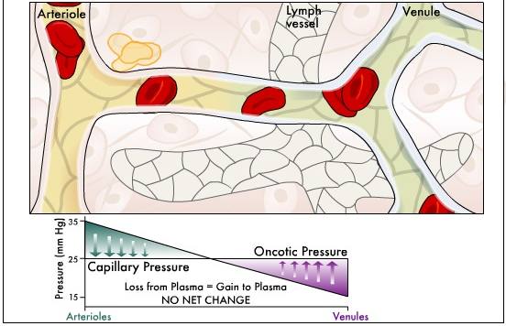
Starling’s Hypothesis
Notes:
Animation
Starling’s Hypothesis
Discuss oncotic pressure.
Discuss the changes in pressure that occur.

Slide 90
Pump Function of the Myocardium
Cardiac Output
Notes:
Point to Emphasize
Cardiac output depends on the amount of blood pumped from the left ventricle with each contraction and the number of times the ventricle contracts each minute.
Teaching Tip
Explain the similarities in the concepts of minute ventilation and cardiac output.
Discussion Questions
What is meant by cardiac output?
A blood clot is obstructing blood flow through the pulmonary artery. Explain how this affects perfusion.

Slide 91
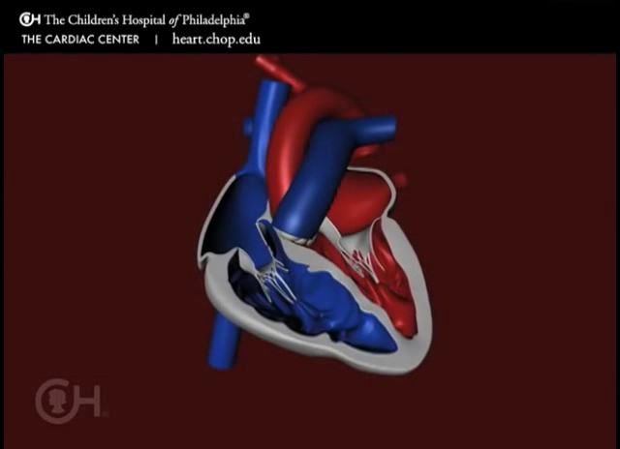
How the Heart Pumps Blood

Slide 92
Cardiac Output
Defined as the amount of blood ejected by the left ventricle in one minute.
Cardiac output for an adult at rest is ~5 liters/minute
  The ventricles pump nearly the body’s entire blood volume through the vascular system in one minute
Cardiac Output = Heart Rate x Stroke Volume

Slide 93
Pump Function of the Myocardium
Heart Rate
(influenced by hormones and the nervous system)
Notes:
Talking Points
Heart rate is defined as the number of times the heart contracts in 1 minute.
The heart has the property of automaticity, meaning it can generate its own impulse. This is achieved through the conduction system with the sinoatrial (SA) node being the primary pacemaker.
The heart rate can also be influenced to increase or decrease its rate of firing by several factors outside of the heart. The primary factors are hormones and the autonomic nervous system, composed of the sympathetic and parasympathetic systems.
The influence of the autonomic nervous system on the heart rate summarized:
– Increased stimulation by the sympathetic system increases heart rate.
– Decreased stimulation by the sympathetic system decreases heart rate.
– Increased stimulation by the parasympathetic system decreases heart rate.
– Decreased stimulation by the parasympathetic system increases heart rate.
Point to Emphasize
The heart rate is influenced by hormones and the nervous system.

Slide 94
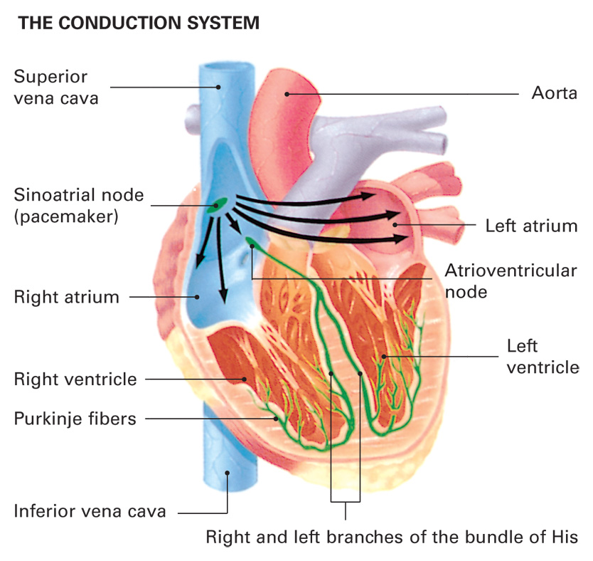
Heart Rate
The sympathetic and parasympathetic nervous systems exert control over heart rate through the cardiovascular control center located in the brainstem.
Notes:
Talking Points
The sympathetic and parasympathetic nervous systems exert control over heart rate through the cardiovascular control center located in the brainstem.
The cardiovascular control center is made up of two parts: the cardioexcitatory center and the cardioinhibitory center.
The cardioexcitatory center increases heart rate by increasing sympathetic stimulation and decreasing parasympathetic stimulation.
The cardioinhibitory center decreases heart rate by decreasing sympathetic stimulation and increasing parasympathetic stimulation.
Direct neural stimulation provides an immediate response in the heart rate and force of ventricular contraction, but hormones can also increase heart rate via epinephrine and norepinephrine release (beta 1 properties).
Discussion Question
What are the effects of the sympathetic and parasympathetic nervous systems on cardiac output?
94

Slide 95
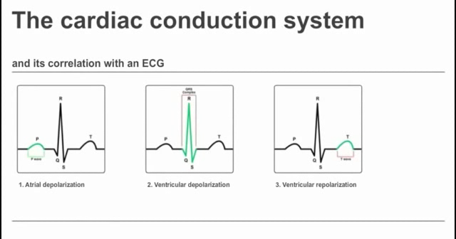

Slide 96
Cardiovascular Control Center
Provides an immediate response in the heart rate and force of ventricular contraction
  Cardioexcitatory center
    Increases heart rate by increasing sympathetic stimulation and decreasing parasympathetic stimulation.
  Cardioinhibitory center
    Decreases heart rate by decreasing sympathetic stimulation and increasing parasympathetic stimulation.
Notes:
Talking Points
The sympathetic and parasympathetic nervous systems exert control over heart rate through the cardiovascular control center located in the brainstem.
The cardiovascular control center is made up of two parts: the cardioexcitatory center and the cardioinhibitory center.
The cardioexcitatory center increases heart rate by increasing sympathetic stimulation and decreasing parasympathetic stimulation.
The cardioinhibitory center decreases heart rate by decreasing sympathetic stimulation and increasing parasympathetic stimulation.
Direct neural stimulation provides an immediate response in the heart rate and force of ventricular contraction, but hormones can also increase heart rate via epinephrine and norepinephrine release (beta 1 properties).
Discussion Question
What are the effects of the sympathetic and parasympathetic nervous systems on cardiac output?
96

Slide 97
Pump Function of the Myocardium
Stroke Volume
(volume of blood ejected by the left ventricle with each contraction)
Notes:
Talking Points
Stroke volume is defined as the volume of blood ejected by the left ventricle with each contraction. Stroke volume is determined by preload, myocardial contractility, and afterload.
Preload is the amount of blood in the left ventricle at the end of diastole.
Afterload is the resistance in the aorta that must be overcome by the left ventricle to move blood forward.
Discussion Question
How does failure of the left ventricle lead to fluid in the lungs?

Slide 98
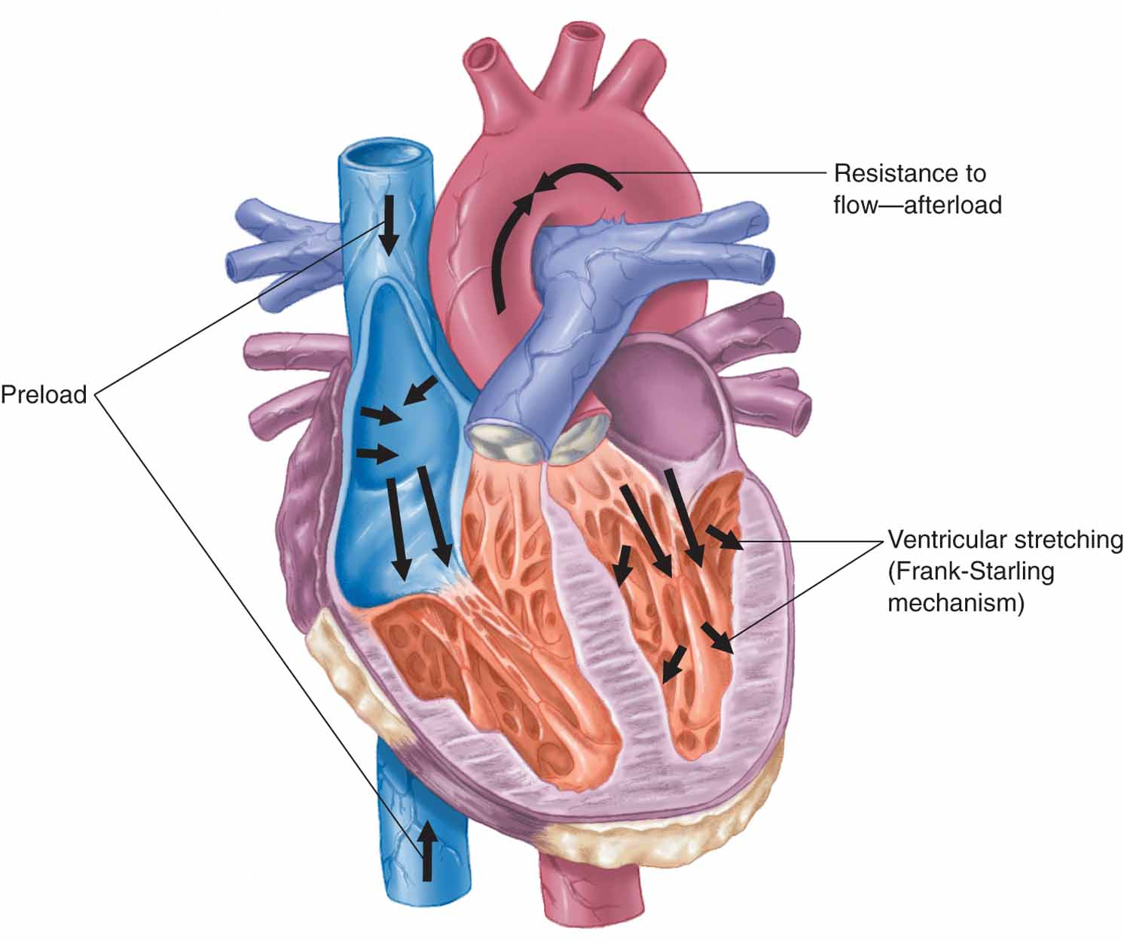
Stroke Volume
Preload
  Pressure generated in the left ventricle at the end of diastole.
  Preload pressure is created by the blood volume in the left ventricle
Starling’s law
  The strength of the heart's systolic contraction is directly proportional to its diastolic expansion
Afterload
  The resistance in the aorta that must be overcome by contraction of the left ventricle to eject the blood
Preload
Starling’s law
Afterload
Notes:
Talking Points
Preload is the pressure generated in the left ventricle at the end of diastole. Preload pressure is created by the blood volume in the left ventricle at the end of diastole.
As blood fills the left ventricle, the muscle fibers stretch to house the blood. The stretch of the muscle fiber at the end of diastole determines the force available to eject the blood from the ventricle. This is known as Starling’s law. As the blood volume increases in the left ventricle, the increased stretch in the muscle fibers generates a commensurate contraction force. In order to have an adequate stroke volume, the left ventricle must be able to generate enough force to effectively eject its blood volume.
Afterload is the resistance in the aorta that must be overcome by contraction of the left ventricle to eject the blood. The force generated by the left ventricle must overcome the pressure in the aorta to move the blood forward.
Discussion Question
How do changes in preload and afterload affect cardiac output?
98

Slide 99
Systemic Vascular Resistance
(resistance to blood flow through a vessel)
Notes:
Talking Points
Systemic vascular resistance is the resistance to blood flow through a vessel. Pressure within the vessels is greatest during cardiac contraction (systole) and least during cardiac relaxation (diastole).
The basic measure of systemic vascular resistance is the diastolic blood pressure because it is assessed during the relaxation phase, indicating the resting pressure within the vessels.
Systolic blood pressure, created by the wave of blood ejected from the left ventricle during contraction, increases the pressure within the vessels beyond their resting pressure.
Discussion Question
How does the release of epinephrine and norepinephrine increase perfusion?

Slide 100
Systemic Vascular Resistance
Pressure within the vessels is greatest during cardiac contraction (systole) and least during cardiac relaxation (diastole).
The basic measure of systemic vascular resistance is the diastolic blood pressure
Systolic blood pressure, created by the wave of blood ejected from the left ventricle, increases the pressure within the vessels beyond their resting pressure.
Notes:
Talking Points
Systemic vascular resistance is the resistance to blood flow through a vessel. Pressure within the vessels is greatest during cardiac contraction (systole) and least during cardiac relaxation (diastole).
The basic measure of systemic vascular resistance is the diastolic blood pressure because it is assessed during the relaxation phase, indicating the resting pressure within the vessels.
Systolic blood pressure, created by the wave of blood ejected from the left ventricle during contraction, increases the pressure within the vessels beyond their resting pressure.
Discussion Question
How does the release of epinephrine and norepinephrine increase perfusion?

Slide 101
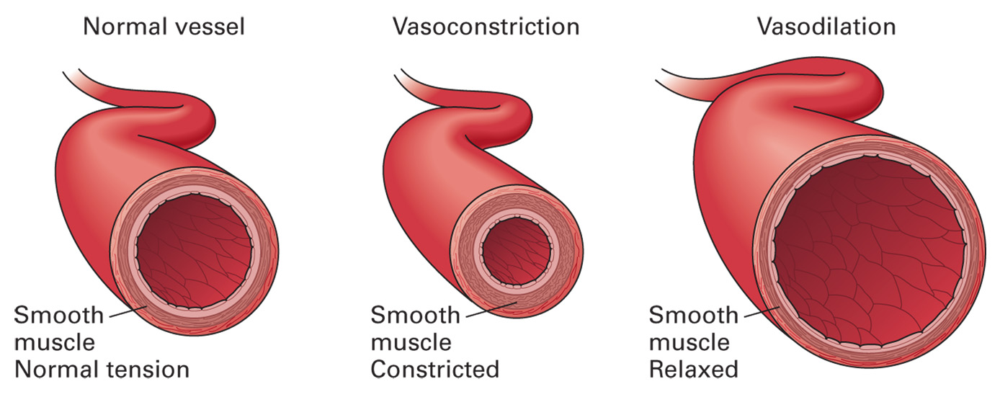

Slide 102
Systemic Vascular Resistance
Vasodilation
  Increases vessel size
  Decreases resistance
  Decreases blood pressure.
Vasoconstriction
  Decreases vessel size
  Increases resistance
  Increases blood pressure.
Notes:
Talking Points
Vasodilation increases vessel size, decreases resistance, and decreases blood pressure.
Vasoconstriction decreases vessel size, increases resistance, and increases blood pressure.
An abnormally high diastolic blood pressure is not a desirable condition. The higher the diastolic blood pressure, the greater the resistance to blood being ejected from the left ventricle, meaning the left ventricle has to work harder to pump blood.
Effects of autonomic nervous system on systemic vascular resistance are:
– Sympathetic stimulation causes vasoconstriction, which decreases vessel diameter and increases systemic vascular resistance.
– Parasympathetic stimulation causes vasodilation, which increases vessel diameter and decreases systemic vascular resistance.
– The alpha 1 properties in epinephrine and norepinephrine, released in response to sympathetic stimulation, cause vasoconstriction, which decreases vessel diameter and increases systemic vascular resistance.
102

Slide 103
Systemic Vascular Resistance
Abnormally high diastolic BP is not desirable
  The higher the diastolic BP, the greater the resistance to blood being ejected from the left ventricle
  Left ventricle has to work harder to pump blood.
Notes:
Talking Points
Vasodilation increases vessel size, decreases resistance, and decreases blood pressure.
Vasoconstriction decreases vessel size, increases resistance, and increases blood pressure.
An abnormally high diastolic blood pressure is not a desirable condition. The higher the diastolic blood pressure, the greater the resistance to blood being ejected from the left ventricle, meaning the left ventricle has to work harder to pump blood.
Effects of autonomic nervous system on systemic vascular resistance are:
– Sympathetic stimulation causes vasoconstriction, which decreases vessel diameter and increases systemic vascular resistance.
– Parasympathetic stimulation causes vasodilation, which increases vessel diameter and decreases systemic vascular resistance.
– The alpha 1 properties in epinephrine and norepinephrine, released in response to sympathetic stimulation, cause vasoconstriction, which decreases vessel diameter and increases systemic vascular resistance.
103

Slide 104
Effects of autonomic nervous system on systemic vascular resistance
Sympathetic stimulation causes vasoconstriction
  Increasing systemic vascular resistance.
    Alpha 1 properties in epinephrine and norepinephrine, cause vasoconstriction, and increases systemic vascular resistance.
Parasympathetic stimulation causes vasodilation
  Decreasing systemic vascular resistance.
Notes:
Talking Points
Vasodilation increases vessel size, decreases resistance, and decreases blood pressure.
Vasoconstriction decreases vessel size, increases resistance, and increases blood pressure.
An abnormally high diastolic blood pressure is not a desirable condition. The higher the diastolic blood pressure, the greater the resistance to blood being ejected from the left ventricle, meaning the left ventricle has to work harder to pump blood.
Effects of autonomic nervous system on systemic vascular resistance are:
– Sympathetic stimulation causes vasoconstriction, which decreases vessel diameter and increases systemic vascular resistance.
– Parasympathetic stimulation causes vasodilation, which increases vessel diameter and decreases systemic vascular resistance.
– The alpha 1 properties in epinephrine and norepinephrine, released in response to sympathetic stimulation, cause vasoconstriction, which decreases vessel diameter and increases systemic vascular resistance.
104

Slide 105
Systemic Vascular Resistance
Systemic Vascular Resistance
Effect on Pulse Pressure
(the difference between the systolic and the diastolic blood pressure readings)
Notes:
Talking Points
The systolic blood pressure is a relative indicator of the cardiac output; whereas, diastolic blood pressure measures the systemic vascular resistance.
If systolic blood pressure is decreasing, it indicates a diminishing cardiac output.
The following describes the effect of the systemic vascular resistance on diastolic blood pressure:
– An increase in the systemic vascular resistance will increase diastolic blood pressure.
– A decrease in the systemic vascular resistance will decrease the diastolic blood pressure.
Discussion Question
What is the significance of a narrow pulse pressure?

Slide 106
Effect on Pulse Pressure
Systemic vascular resistance
Diastolic blood pressure
Systemic vascular resistance
Diastolic blood pressure
Notes:
Talking Points
The pulse pressure is the difference between the systolic and the diastolic blood pressure readings.
If the patient has a blood pressure of 132/74 mmHg, the pulse pressure would be derived by subtracting the diastolic from the systolic. In this case, the pulse pressure would be 58 mmHg (132 – 74 = 58).
A narrow pulse pressure is defined as being less than 25 percent of the systolic blood pressure reading. In this case, a narrow pulse pressure would be less than 33 mmHg (132 x 25% = 33 mmHg).
Knowledge Application
Given several blood pressure values, determine the pulse pressure.
106

Slide 107
Pulse Pressure
(Systolic BP) - (Diastolic BP)
Measured in millimeters of mercury
  Ex: 120/80 = Pulse Pressure of 40 mmHg
    (120 - 80)
Resting, Healthy adults, Sitting position
  30-40 mmHg.
Increases with exercise
  Due to increased stroke volume
  Up to about 100 mmHg

Slide 108
Pulse Pressure
(Systolic BP) - (Diastolic BP)
Narrow (Low)
  less than 25% (¹/₄) of the systolic value
Narrow (Low) suggests
  Drop in left ventricular stroke volume.
  In trauma suggests significant blood loss (insufficient preload)
  Ex: 108/88 = 20 (25% of 108 (=> 108/4) =27)
    BP looks "OK", but low Pulse Pressure suggests concern

Slide 109
Pulse Pressure
(Systolic BP) - (Diastolic BP)
If Consistently High (greater than 100 mmHg) suggests
  stiffness of the major arteries
  aortic regurgitation
  arteriovenous malformation
High resting pulse pressure is harmful
  Tends to accelerate the normal aging of body organs, particularly the heart, the brain and kidneys.

Slide 110
Microcirculation
(the flow of blood through the smallest blood vessels—the arterioles, capillaries, and venules)
Notes:
Talking Points
Microcirculation is the flow of blood through the smallest blood vessels—the arterioles, capillaries, and venules.
The true capillaries are the sites of exchange of nutrients, oxygen, carbon dioxide, glucose, waste products, and metabolic substances between the blood and the cells.

Slide 111
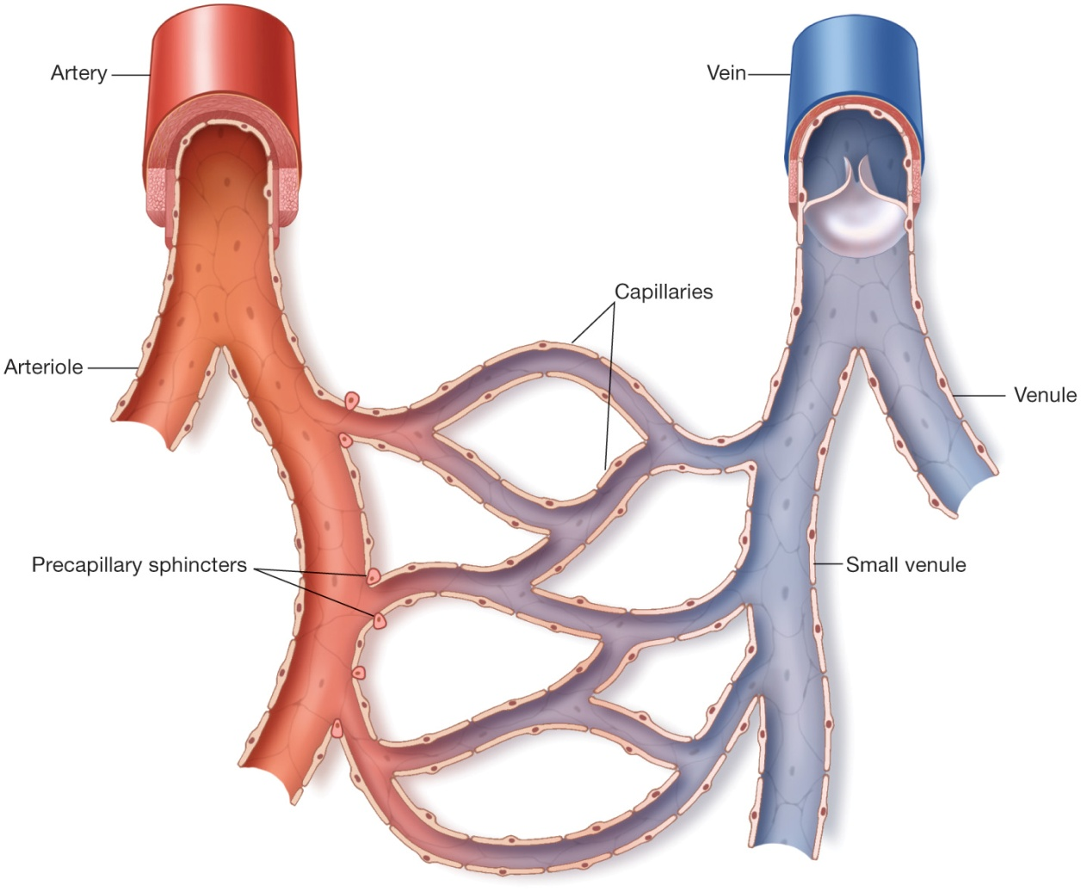
Site of exchange
Metarterioles
  Connect the arterioles and venules.
  True capillaries branch from the metarterioles
Precapillary sphincters
Regulatory influences
  Local factors
  Neural factors
  Hormones
Notes:
Talking Points
Metarterioles are described often as thoroughfares or channels that connect the arterioles and venules. True capillaries branch from the metarterioles.
Precapillary sphincters control the movement of blood through the true capillaries. If the precapillary sphincter is relaxed, blood moves through the capillary. If the precapillary sphincter is contracted, the blood is shunted away from the true capillary.
Three regulatory influences control blood flow through the capillaries:
– Local factors are found immediately around or within the capillary structure, such as temperature, hypoxia, acidosis, and histamine.
– Neural factors are associated with the sympathetic and parasympathetic nervous systems on the arterioles and precapillary sphincters. Neural factors cause the arterioles to constrict/dilate and precapillary sphincters to close/open.
– Hormones may also control movement of blood through the capillaries, such as with alpha 1 stimulation from epinephrine causing arterioles to constrict and precapillary sphincters to close.
111

Slide 112
Blood Pressure
Systolic BP is a measure of cardiac output.
Diastolic BP is a measure of systemic vascular resistance.
Increase in blood pressure improves the delivery of oxygen to the brain cells and the removal carbon dioxide.
Notes:
Talking Points
The systolic blood pressure is a measure of cardiac output.
The diastolic blood pressure is a measure of systemic vascular resistance.
The body’s compensation mechanisms are geared toward maintaining pressure inside the vessel and perfusion of the cells.
Point to Emphasize
Blood pressure is determined by cardiac output and systemic vascular resistance.

Slide 113
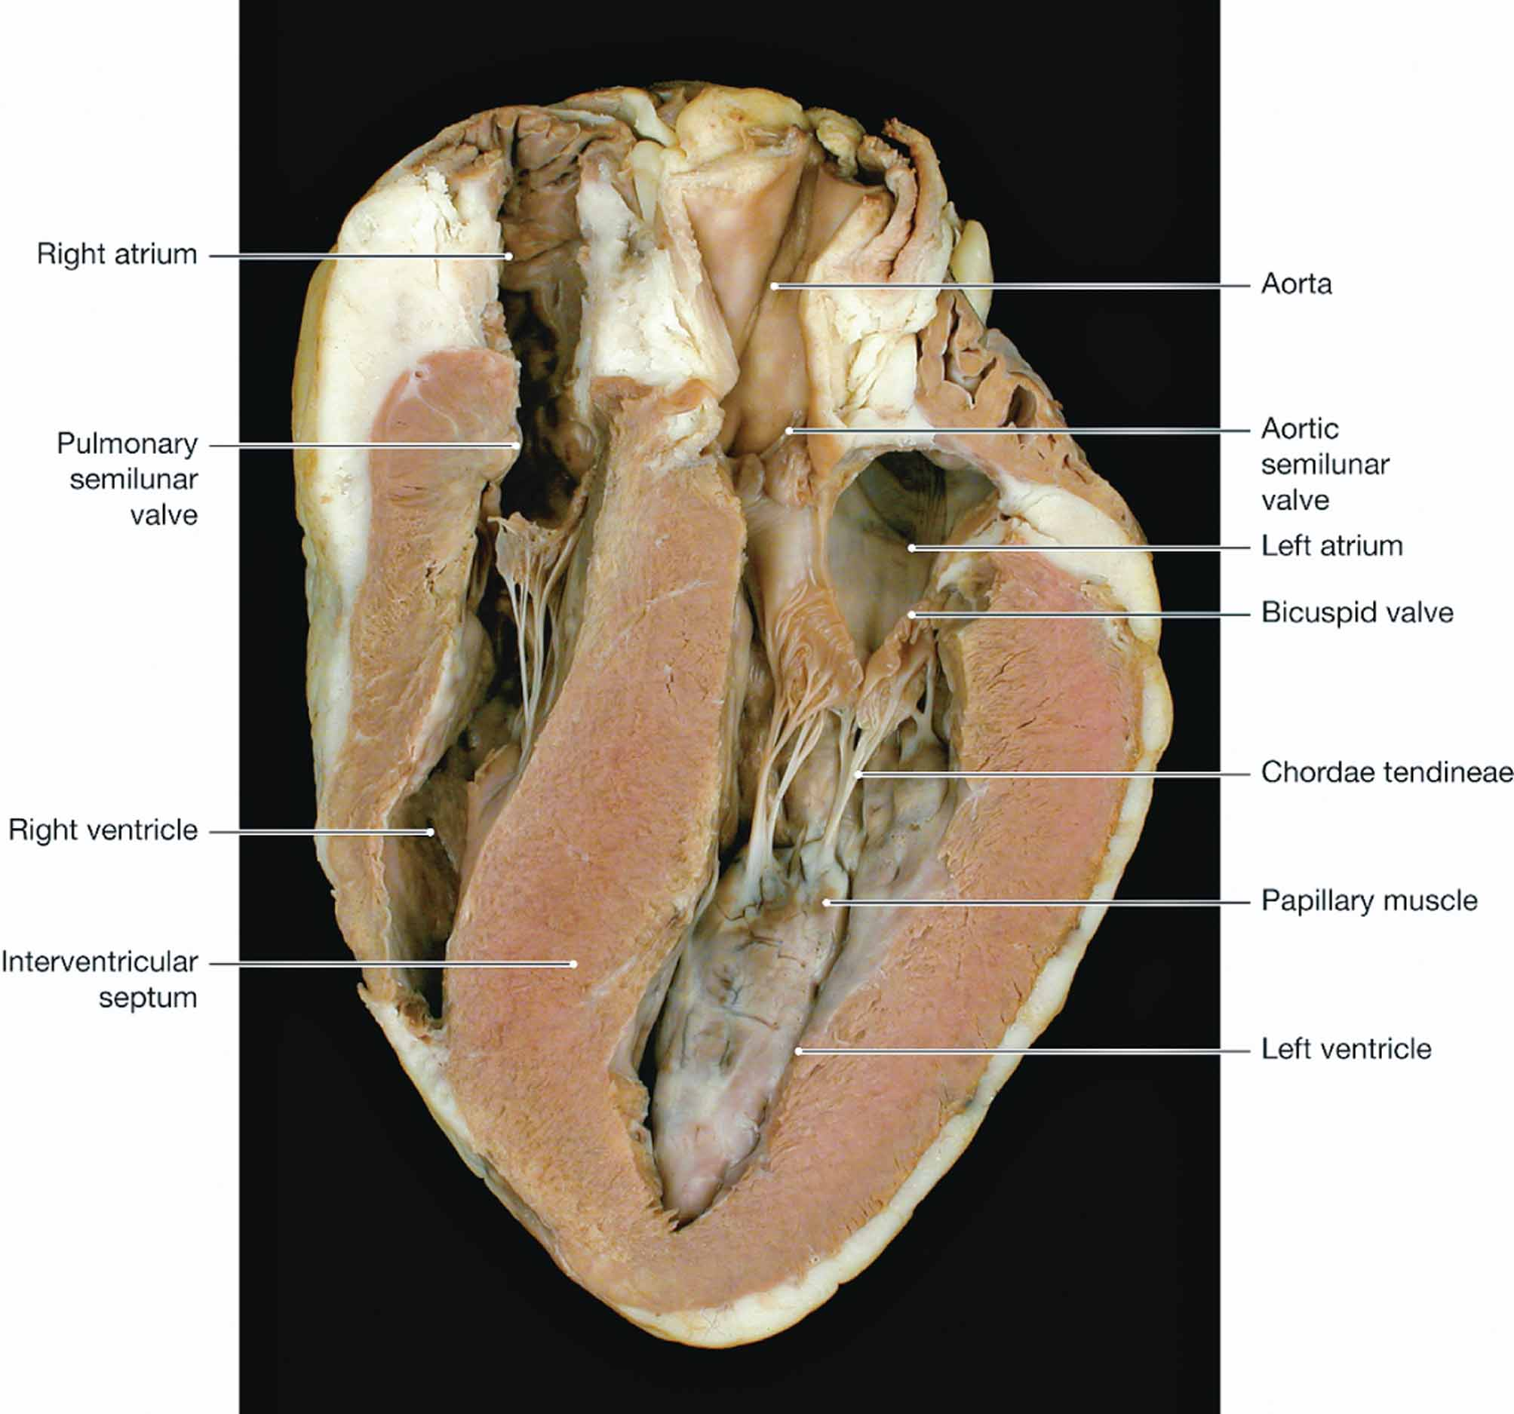
Notes:
Talking Points
Perfusion of cells is linked to the blood pressure. In order to maintain adequate perfusion, the blood must be pushed with enough force to constantly deliver oxygen and glucose to the cells and remove carbon dioxide and other waste products.
The general effect of blood pressure on perfusion is:
– An increase in blood pressure will increase cellular perfusion.
– A decrease in blood pressure will decrease cellular perfusion.
113

Slide 114
Systemic vascular resistance
Blood pressure
Cardiac output
Increase in blood pressure will increase cellular perfusion.
Decrease in blood pressure will decrease cellular perfusion.
Decrease in Systolic BP = Suggests Decreased Cardiac output
Increase in Diastolic BP = Suggests Increase in Systemic vascular resistance
Notes:
Talking Point
The blood pressure is derived by multiplying two major factors: cardiac output and systemic vascular resistance:
Blood pressure (BP) = Cardiac output (CO) x Systemic vascular resistance (SVR)
114

Slide 115
Blood Pressure
Regulation of Blood Pressure by Baroreceptors and Chemoreceptors
Baroreceptors: Sense "stretch" from pressure of blood in aorta and carotid sinuses.
Chemoreceptors: Monitor the content of O₂, CO₂, hydrogen ions, and the pH of the blood
Notes:
Talking Points
Baroreceptors are sensitive to the amount of stretch placed on them by the pressure of blood moving through the aorta and carotid sinuses.
Chemoreceptors monitor the content of oxygen, carbon dioxide, hydrogen ions, and the pH of the blood.
The blood pressure is monitored and regulated by both baroreceptors and chemoreceptors.

Slide 116
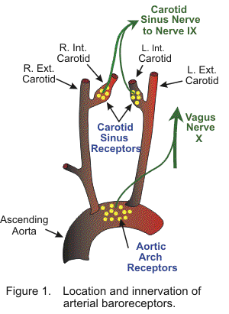
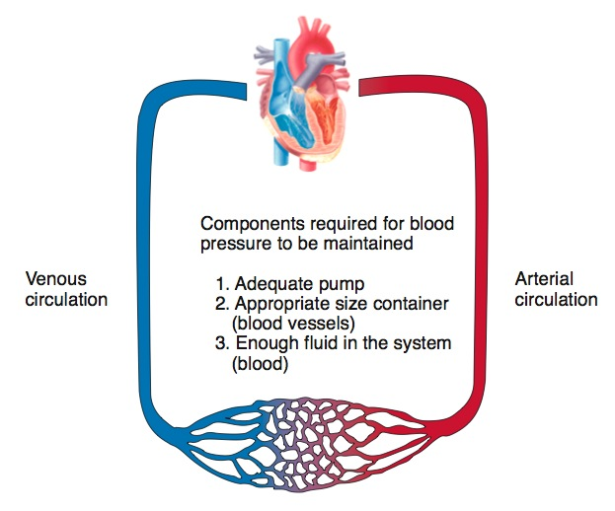
Regulation of Blood Pressure
Baroreceptors
Chemoreceptors
Notes:
Talking Points
Baroreceptors are stretch-sensitive receptors, located in the aortic arch and carotid sinuses, that detect changes in blood pressure. As the pressure inside the vessels changes, it decreases or increases the stretch of the fibers of the baroreceptors. The baroreceptors, having thus detected he in the blood pressure.
Chemoreceptors monitor the content of oxygen, carbon dioxide, hydrogen ions, and the pH of the blood. The greatest stimulation to change the blood pressure occurs when the oxygen content in arterial blood decreases. An increase in the carbon dioxide level and a decrease in the pH (more acid) have a lesser effect on increasing blood pressure. The increase in blood pressure improves the delivery of oxygen to the brain cells and the removal carbon dioxide.
116

Slide 117

Patient Assessment
CASE STUDY
Patient states his name is Paul
Patient is alert, oriented, has open airway, breathing adequately
Respirations: 24 per minute; skin cool and clammy
Heart rate: 122 and weak
Placed on nonrebreather mask at 15 lpm
Notes:
Case Study Follow-Up Discussion, continued
The patient is moaning and clutching his abdomen. He states, “Paul … my name is Paul. I can’t believe she stabbed me. I just wanted to watch the football game in peace.” From his response, you gather he is alert, oriented to name, has an open airway, and is breathing adequately.
The patient is breathing at 24 per minute and slightly shallow. You think that his minute ventilation appears to be slightly increased because of an increased ventilatory rate, but you want to be sure his alveolar ventilation is also adequate. His chest is rising and falling adequately with each breath, so he’s moving enough tidal volume to sustain the alveolar ventilation.
His radial pulse is barely palpable and his skin is pale, cool, and clammy. You expect the skin is pale, cool, and clammy as a result of vasoconstriction from sympathetic nervous stimulation and circulating epinephrine and norepinephrine. The weak pulse is likely due to a loss of volume, a decreased preload, and a decreased cardiac output and intense peripheral vasoconstriction. His heart rate is 122 bpm.
Your partner places him on a nonrebreather mask at 15 lpm in an attempt to fill the alveoli with a high concentration of oxygen to attach as many oxygen molecules as possible to the binding sites on the hemoglobin in the blood.
117

Slide 118
Patient Assessment
CASE STUDY
BP: 102/88 mmHg
Cover stab wounds in abdomen
Transport to hospital
Give report
Notes:
Case Study Follow-Up Discussion, continued
You perform a quick head to toe, looking for other injuries and signs. The abdomen is rigid and tender when you palpate it. You suspect this is from blood loss in the abdominal cavity. Vital signs are BP 102/88, HR 122, RR 24, and skin pale, cool, and clammy.
The pulse pressure appears to be narrow. A quick mental calculation determines that 25 percent of 100 is 25; the pulse pressure should be 25 or greater. You subtract the diastolic BP from the systolic and get 14 mmHg. You suspect the narrow pulse pressure is due to blood loss from the stab wounds, causing a drop in preload and a decrease in stroke volume and cardiac output.
You cover the wounds and prepare the for transport. En route you continually reassess, contact the receiving medical facility, and provide a radio report.
Case Study Follow-Up Discussion Questions
What is going on at the patient’s cellular level?
How can your actions address the problems at the patient’s cellular level?
118

Slide 119
Critical Thinking Scenario

Slide 120
Critical Thinking Scenario
28-year-old construction worker who sustained a large, gaping laceration to his left upper leg
Blood is spurting from the wound
Responds only with moans when you yell his name
Notes:
Critical Thinking Discussion
This critical thinking scenario is intended to challenge your students to think about assessing a deteriorating trauma patient based on anatomic and physiologic thinking. Get students to think about the underlying etiology for all the ways the patient is presenting.
The scenario continues on the next slide.

Slide 121
Critical Thinking Scenario
Vital signs:
BP: 98/76 mmHg
HR: 134 bpm, radial pulse is absent
RR: 26 per minute
Skin is extremely pale, cool, and clammy
Notes:
Critical Thinking Discussion, continued
Ask students to briefly discuss the scenario before moving on to the series of questions on the next slide.

Slide 122
Critical Thinking Questions
In order to determine if his ventilation is adequate, what else must you assess?
Based on the ventilation/perfusion ratio, why would the cells in the patient become and remain hypoxic?
Why is the patient responding so poorly?
Even though the heart rate is above normal, cardiac output is diminished because stroke volume is hampered by significant blood loss. Without adequate cardiac output, mental status, skin condition, and distal pulses will deteriorate.
Ensure that he has a patent airway and has adequate chest rise. Listen to his chest to determine if lung sounds are clear and equal bilaterally. If available, measure his oxygen saturation with a pulse oximeter.
Radial pulses are absent => poor perfusion due to blood loss. Even if ventilating effectively, capillary perfusion to the lungs is diminished and O₂-carrying capacity of blood is hampered. Cells become hypoxic as hemoglobin will be less saturated with O₂.
Notes:
Critical Thinking Discussion, continued
Answers:
Because of his level of consciousness, don’t assume that he can adequately support his own airway. Ensure that he has a patent airway and has adequate chest rise. If time permits, listen to his chest to determine if lung sounds are clear and equal bilaterally. If available, you could also measure his oxygen saturation with a pulse oximeter.
The patient’s radial pulses are absent, a sign of poor perfusion likely due to the blood loss. Even if the patient is ventilating effectively, capillary perfusion to the lungs is likely diminished and the oxygen-carrying capacity of blood will be hampered. Cells will become hypoxic at the tissue level because hemoglobin will be less saturated with oxygen.
Even though the patient’s heart rate is above normal limits, his cardiac output is likely diminished because stroke volume has been hampered through significant blood loss. Without adequate cardiac output, the patient’s mental status, skin condition, and distal pulses will indicate deterioration.

Slide 123
Critical Thinking Questions
How is the spurting blood affecting the perfusion of the cells?
What is causing a decrease in the systolic blood pressure?
Is the pulse pressure narrow? If so, describe why.
Why is the skin pale, cool, and clammy?
Spurting from the wound => bleeding from an artery. Blood loss has been rapid and more devastating. Cellular perfusion is affected as cardiac output is diminished, alveolar perfusion is reduced, and oxygenation of the cells is decreased.
Cardiac output is diminished as stroke volume is reduced. Stroke volume is the volume of blood ejected by the left ventricle per minute. Because of blood loss, stroke volume has reduced cardiac output even though heart rate has risen.
Subtract the diastolic from the systolic (98 – 76 = 22). A narrow pulse pressure is defined as <25% of the systolic. A narrow pulse pressure would be <24.5 (98 x 25% = 24.5). At 22, narrow and sign of significant blood loss.
An early sign of hypoxia in a patient is pale, cool, and clammy skin due to vasoconstriction from the sympathetic nervous system attempting to increase systemic vascular resistance.
Notes:
Critical Thinking Discussion, continued
Answers:
Blood spurting from the wound suggests bleeding from an arterial vessel and the blood loss has been rapid and more devastating compared to laceration of a vein. Cellular perfusion is affected because cardiac output is diminished, alveolar perfusion is reduced, and oxygenation of the cells is decreased.
Cardiac output is likely diminished because stroke volume is reduced. Remember, stroke volume is defined as the volume of blood ejected by the left ventricle per minute. Because of blood loss, his stroke volume has reduced cardiac output even though his heart rate has risen to compensate.
Subtract the diastolic pressure from the systolic pressure (98 – 76 = 22). The pulse pressure is 22 mmHg. To determine if it is “narrow,” do a second calculation. A narrow pulse pressure is defined as being less than 25 percent of the systolic (98 x 25% = 24.5). A narrow pulse pressure would be less than 24.5. This patient has a pulse pressure of 22. His pulse pressure is narrow and likely a sign of significant blood loss causing a drop in cardiac output and an increase in systemic vascular resistance.
An early sign of hypoxia in a patient is pale, cool, and clammy skin due to vasoconstriction from the sympathetic nervous system attempting to increase systemic vascular resistance.

Slide 124
Critical Thinking Questions
Why is the heart rate 134 bpm?
Are the cells of this patient likely undergoing aerobic or anaerobic metabolism? Why?
Why does the patient have such a lack of energy?
Heart rate is elevated to compensate for the diminished stroke volume in an attempt to keep cardiac output normal and maintain blood pressure.
Likely a combination of both. Though hypoxic, some O₂ is being delivered to the tissues, so aerobic metabolism can occur. Energy demands of the body are going unfulfilled, and some cells will use fuels without O₂ which generates acid.
Significant blood loss and cellular hypoxia can quickly result in an alteration of the patient’s mental status.
Notes:
Critical Thinking Discussion, continued
Answers:
Heart rate is elevated to compensate for the diminished stroke volume in an attempt to keep cardiac output normal and maintain blood pressure.
Cellular metabolism in this patient is likely a combination of both aerobic and anaerobic metabolism. Even though the cells are hypoxic, there is still some oxygen being delivered to the tissues, and aerobic metabolism can occur. But energy demands of the body are likely going unfulfilled, and some cells have resorted to using fuels without oxygen, which generates acid.
Significant blood loss and cellular hypoxia can quickly result in an alteration of the patient’s mental status.

